Slide 1
Invitation to Serve
Good practices from experience

Slide 2
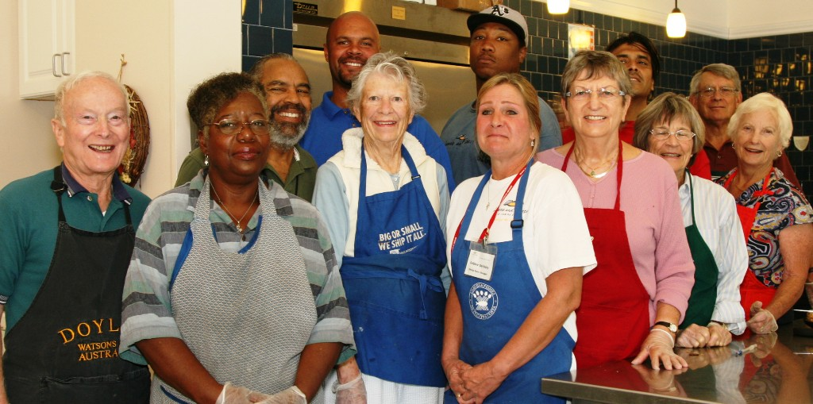
Mission Statement
A network of friends, inspired by Gospel values, growing in holiness and building a more just world through personal relationships with and service to people in need.
“The Society is open to all those who seek to live their faith loving and committing themselves to their neighbor in need.” (Rule, Part I, 3.1)

Slide 3
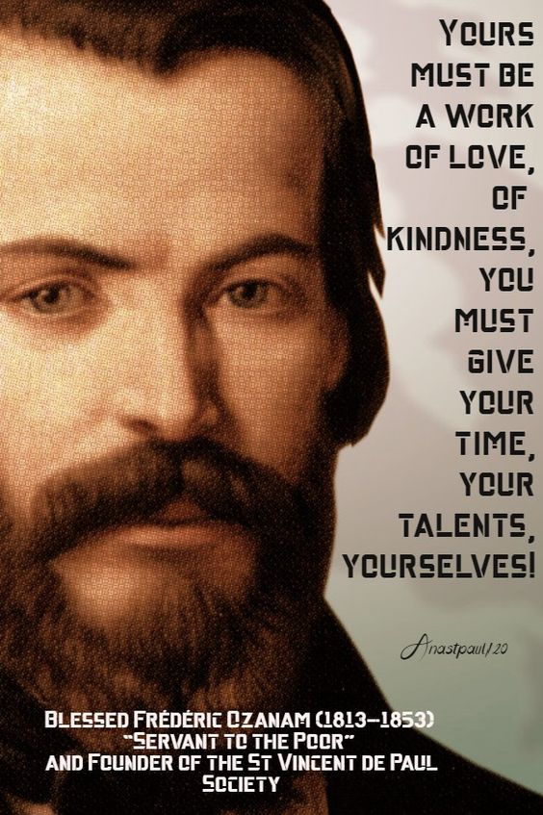
“The Society is open to all those who seek to live their faith loving and committing themselves to their neighbor in need.” (Rule, Part I, 3.1)
Even strong Conferences must recruit. A healthy Conference will have a slow but steady turnover of membership.
Conferences must periodically reach out so that the congregation knows that they are open to new members: men and women, young people, various ethnic groups
The benefits are best shared by a Vincentian on a personal note:
You will be serving God.
You will be growing spiritually.
You will be helping those in need.
You will be working with a dedicated group of Vincentians.
You are needed.

Slide 4
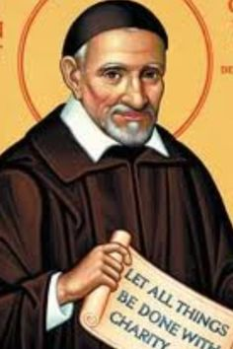
Pulpit Appeal
Contact the Pastor several weeks ahead to schedule the appeal at the Parish Masses. Give the pastor a draft of the presentation.
A few weeks prior place some announcements in the bulletin about the Society of St. Vincent de Paul and the works that are being done in the parish.
Have Vincentians with personal experiences share. It is also very beneficial if the celebrant can also support the presentation.

Slide 5
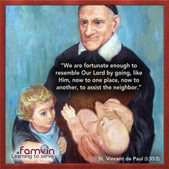
Guidelines for the Pulpit Message
A Vincentian that is comfortable speaking before a group will:
Introduce yourself, your role, and thank the pastor/celebrant for the opportunity to speak
Speak slowly and clearly using the microphone
Prepare your speech or notes to guide you to speak from your experiences
Sharing stories and experiences are helpful - confidentiality a must.
Share the needs of your Conference – list several
Inform them of an orientation meeting.
Invite them to sign-up sheets after Mass and have Vincentians available to answer questions
Post an Exhibit that shows the works of the Society

Slide 6
Suggestions for the Orientation Meeting
Schedule meeting for an evening a week or two after the presentation at the Masses
Hold the meeting at a parish facility and reserve the space and time well in advance.
Contact each prospective member personally to remind them of the meeting.
Keep the meeting within an hour
Show the 9-minute DVD on history of the Society
Share the history of your own Conference and the works you do
Discuss the requirement for the safe environment policy of the (Arch) Diocese
Share the experience of a home visit and the confidentiality required
Share the importance of Vincentian spiritual formation
Allow for questions and dialogue
Invite them to the next official conference meeting

Slide 7
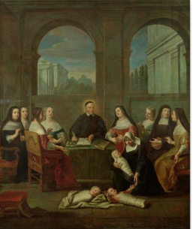
Orientation Meeting Agenda
Opening prayer
Spiritual reading and reflection
Introduction of Vincentians
Introduction of Guests
History of Society of St. Vincent de Paul – video
Describe our work and how it is done
Home visits
Work in pairs
Confidentiality
Meeting times and duration
Society in the Council
Vincentian Formation Opportunities
Meeting the Safe Environment Policy of the Arch/Diocese
Closing Prayer
Refreshments and Social

Slide 8
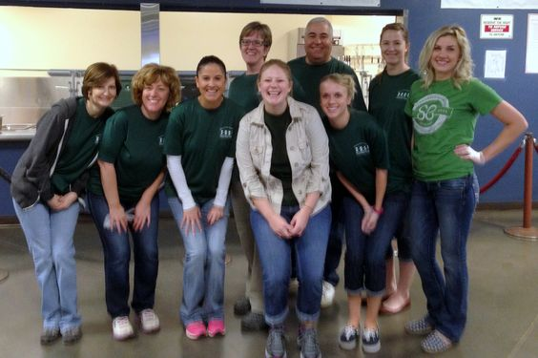
Welcome new/prospective members
Provide them a mentor Vincentian
Schedule a welcome with your President or Spiritual Advisor
Provide Conference process orientation
Have them attend an Ozanam Orientation and other training
After some exposure to the Conference, ask them to discern being a Vincentian.
If they agree, commission them

