Slide 1
FOOD PANTRY
Hours of Operation
Tuesday 12 Noon – 8 PM
Friday 12 Noon – 8 PM
Saturday 9 AM – 1 PM
If we’ve missed you, and you would like to schedule an appointment, you can call:
2-1-1 or 614-341-2282 from anywhere in Franklin county
Mon, Wed, Fri 7AM-4PM; Tue, Thur 7AM-8PM through HandsOn Central Ohio or call
The Pantry office at 614-317-9487 on Sunday night at midnight.
Please leave a message. We will return calls on Mondays until we are fully booked for the following week.

Slide 2
During your visit to the pantry:
We will do our best to make sure you receive at least 3 days worth of
healthy and nutritious food for each member of your household.
You will be treated with kindness and respect by our volunteers and
staff that are here to help you.
- During your visit it is possible that a group taking a tour of the Foodbank will come through the pantry. The tour leader will do his/her best to not interfere with your shopping.
- On occasion, members of the media (TV, radio, newspaper) do come to the Foodbank to learn about hunger in our community. You are, by no means, required to speak with them.
Mid-Ohio Foodbank’s Vision:
To build and sustain a community that make food accessible to all people.
Mid-Ohio Foodbank’s Mission:
Mid-Ohio Foodbank is dedicated to feeding hungry people by collecting and distributing food and grocery products, educating the community about hunger, advocating for hunger-relief programs, and collaborating with others who address basic human needs.

Slide 3
So that we can serve everyone in the
quickest manner possible:
Please don’t begin shopping until your name has been called by one of the teammates from the pantry.
Please wait in either the front lobby or our pantry waiting room. This will allow us to have room for other shoppers and our pantry team to move about safely.
Also, please remember that there is to be
NO SMOKING anywhere on the Mid-Ohio
Foodbank property. Thank you !

Slide 4
Right to Refuse Service Policy:
In order to maintain a high standard of service and provide a safe work
environment for its employees, volunteers, and client families, Mid-Ohio
Foodbank (MOFB) reserves the right to refuse or discontinue service to
food pantry clients. Service may be denied to any client who acts inappropriately by disrupting the normal provision of services, or if a client’s behavior or environment threatens the safety of MOFB’s employees, volunteers, or client families.
Inappropriate behavior includes, but is not limited to the following:
- Unreasonable demands for service - Threatening or erratic behavior
- Misrepresentation for the need for service - Inappropriate physical contact
- Personally threatening and offensive language
Any MOFB employee or volunteer can exercise the right to refuse service when confronted by a client acting inappropriately or when facing an unsafe situation. They will notify their supervisor of the situation immediately.

Slide 5
SOUP
Family Size | 1-2 | 3-4 | 5-6 | 7-8 | 9-10 | 11-12+
Choices | 2 | 3 | 3 | 4 | 4 | 5
PROTEIN
Beans, Meats, Peanut Butter
Family Size | 1-2 | 3-4 | 5-6 | 7-8 | 9-10 | 11-12+
Choices | 2 | 2 | 3 | 4 | 4 | 5

Slide 6
Family Size | 1-2 | 3-4 | 5-6 | 7-8 | 9-10 | 11-12+
Choices
EGGS
Family Size | 1-2 | 3-4 | 5-6 | 7-8 | 9-10 | 11-12+
Choices

Slide 7
VEGETABLES
Family Size | 1-2 | 3-4 | 5-6 | 7-8 | 9-10 | 11-12+
Choices | 2 | 2 | 3 | 4 | 4 | 5
FRUITS
Family Size | 1-2 | 3-4 | 5-6 | 7-8 | 9-10 | 11-12+
Choices | 2 | 2 | 3 | 4 | 4 | 5

Slide 8
DESSERTS & COOKIES
Family Size | 1-2 | 3-4 | 5-6 | 7-8 | 9-10 | 11-12+
Choices | 1 | 2 | 2 | 3 | 4 | 4
CRACKERS & SNACKS
Family Size | 1-2 | 3-4 | 5-6 | 7-8 | 9-10 | 11-12+
Choices | 1 | 2 | 2 | 3 | 4 | 4

Slide 9
MISC FROZEN FOODS
Family Size | 1-2 | 3-4 | 5-6 | 7-8 | 9-10 | 11-12+
Choices | 2 | 2 | 3 | 3 | 4 | 4
FROZEN MEAT
big packs for 6+ families
Family Size | 1-2 | 3-4 | 5-6 | 7-8 | 9-10 | 11-12+
Choices | 2-3 lbs | 4-6 lbs | 6-8 lbs | 8-12 lbs | 10-14 lbs | 12-16 lbs

Slide 10
CEREAL
Family Size | 1-2 | 3-4 | 5-6 | 7-8 | 9-10 | 11-12+
Choices | 2 | 3 | 4 | 4 | 5 | 6
PASTA, RICE
Family Size | 1-2 | 3-4 | 5-6 | 7-8 | 9-10 | 11-12+
Choices | 1 | 2 | 2 | 3 | 4 | 5

Slide 11
BREAD, BUNS,
BAGELS, ETC.
Family Size | 1-2 | 3-4 | 5-6 | 7-8 | 9-10 | 11-12+
Choices | 2 | 3 | 5 | 7 | 9 | 11
BREAD, BUNS,
BAGELS, ETC.
Family Size | 1-2 | 3-4 | 5-6 | 7-8 | 9-10 | 11-12+
Choices | 2 | 3 | 5 | 7 | 9 | 11

Slide 12
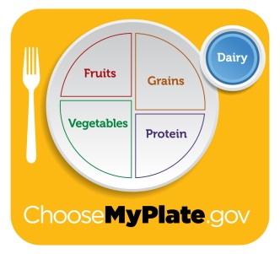
MILK
Family Size | 1-2 | 3-4 | 5-6 | 7-8 | 9-10 | 11-12+
Choices | ½ gal | 1 gal | 1 gal | 1 ½ gal | 1 ½ gal | 2 gal
Refrigerated Items
Family Size | 1-2 | 3-4 | 5-6 | 7-8 | 9-10 | 11-12+
Choices | 2 | 3 | 3 | 4 | 5 | 5

Slide 13
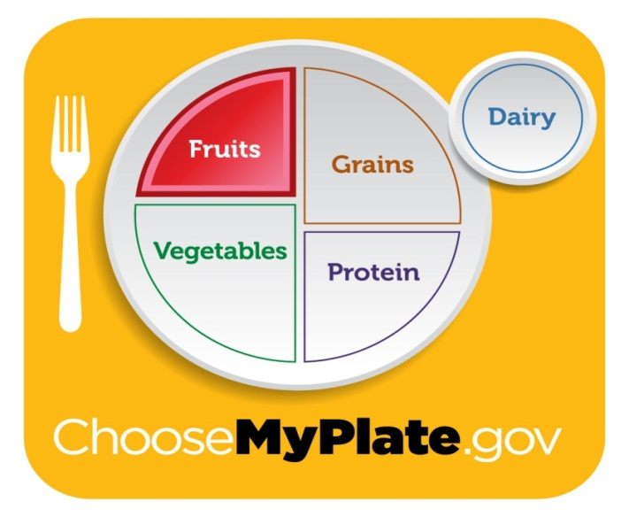
FRESH & WHOLESOME
VEGETABLES
FRUITS
Family Size | 1-2 | 3-4 | 5-6 | 7-8 | 9-10 | 11-12+
Fruits | 6 | 6 | 6 | 6 | 6 | 6
Vegetables | 6 | 6 | 6 | 6 | 6 | 6

Slide 14
EGGS
Family Size | 1-2 | 3-4 | 5-6 | 7-8 | 9-10 | 11-12+
Choices | 1 doz | 1 doz | 2 doz | 2 doz | 2 doz | 3 doz

Slide 15
MILK
Family Size | 1-2 | 3-4 | 5-6 | 7-8 | 9-10 | 11-12+
Choices | ½ gal | 1 gal | 1 gal | 1 ½ gal | 1 ½ gal | 2 gal

Slide 17
VEGETABLES

Slide 18
FRUITS

Slide 19
GRAINS

Slide 20
PROTEIN

Slide 21
DAIRY

Slide 22
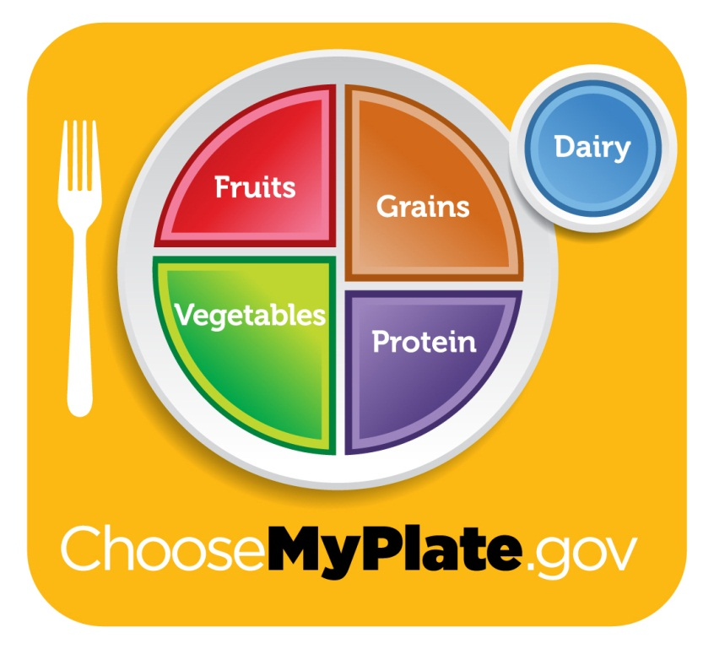
FROZEN FOODS

Slide 23
BEEF

Slide 24
PORK

Slide 25
CHICKEN

Slide 26
VENISON

Slide 27
TURKEY

Slide 28
SEAFOOD

Slide 29
COLD CUTS

Slide 30
EGGS

Slide 31
MILK

Slide 32
YOGURT

Slide 33
MARGARINE

Slide 34
PUDDING

Slide 35
CHEESE

Slide 36
ICE CREAM

