Slide 1
Training Our Spiritual Advisors New Formation Resources
James Davis
South Central Region
Spiritual Advisor
Tim Williams
Diocesan Council of Dallas
Senior Formator

Slide 2
Opening Prayer
Notes:
Handout

Slide 3
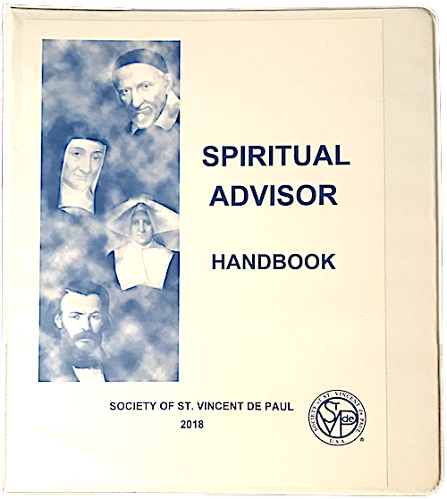
Training Answers These Questions
Am I holy enough?
I’m a Spiritual Advisor. Now what?
Notes:
Yes!
Last year we introduced a new Spiritual Advisor Handbook. It is meant for new SAs and experienced ones alike. It is intended to provide enough information to help you get started, and pointers to further reading you may do on your own.

Slide 4
Spiritual Advisor Training Agenda
9:00 | - | 9:15 | Centering and Opening Prayer
9:15 | - | 9:20 | Objectives and Agenda
9:20 | - | 10:20 | What is Vincentian Formation?
10:20 | - | 10:30 | Break
10:30 | - | 11:30 | Spiritual Advisor Roles and Responsibilities
11:30 | - | 12:00 | Resources and Reflections
12:00 | - | 12:45 | Lunch
12:45 | - | 1:45 | Resources and Reflections
1:45 | - | 2:00 | Break
2:00 | - | 2:55 | Vincentian Discernment and Consensus
2:55 | - | 3:00 | Closing Prayer
What is Vincentian Formation?
Spiritual Advisor Roles and Responsibilities
Resources and Reflections
Vincentian Discernment and Consensus
Notes:
This year, we’ve developed a full day training workshop for Spiritual Advisors, and the full PPT, speaker notes, and additional resources are available now for Diocesan Council and Regional Formators and Spiritual Advisors.

Slide 5
What Is Vincentian Formation?
A Lifelong Process of Becoming

Slide 6
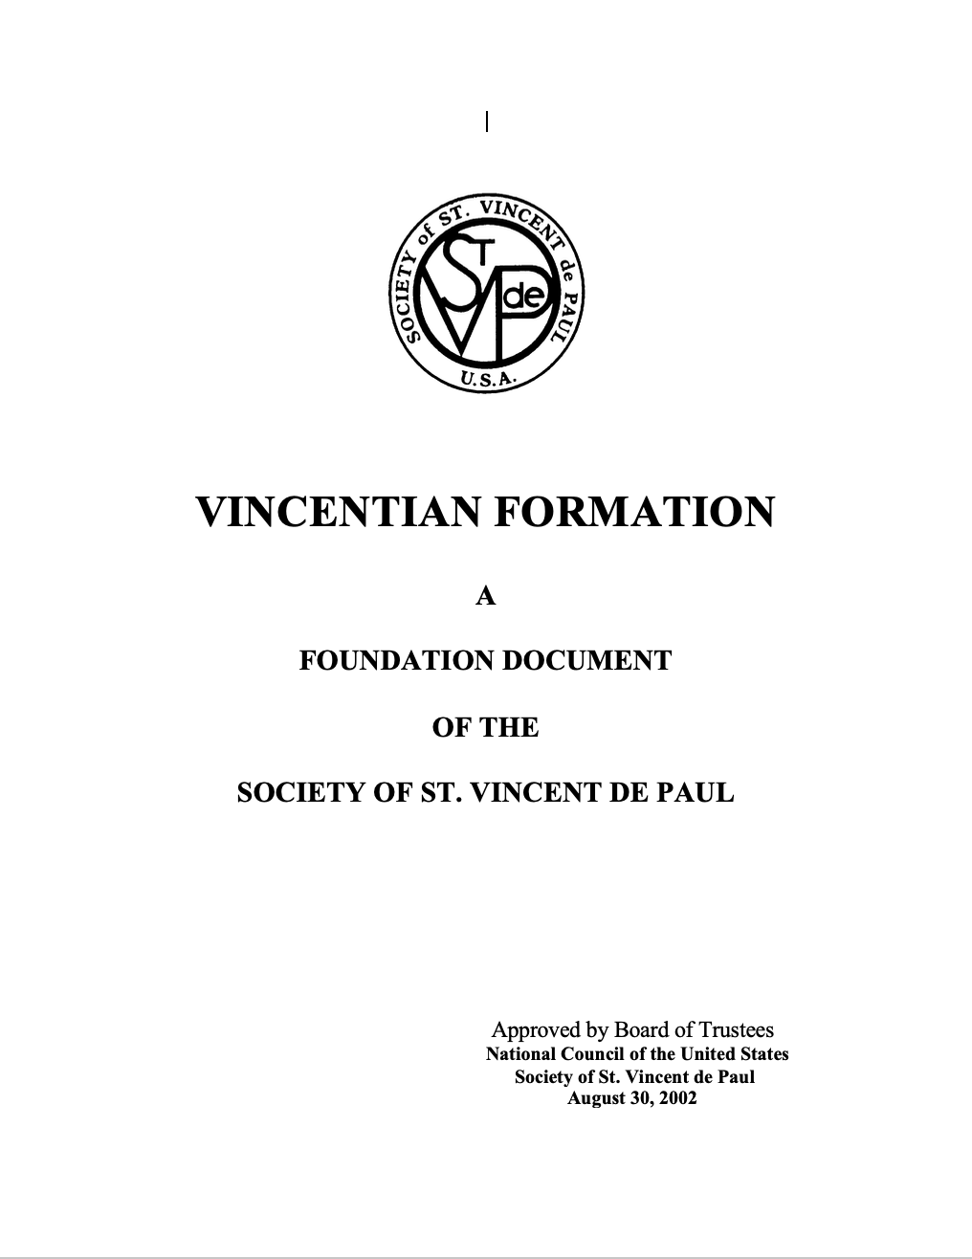
A Foundation Document
Notes:
The source for this module (included in handbook)

Slide 7
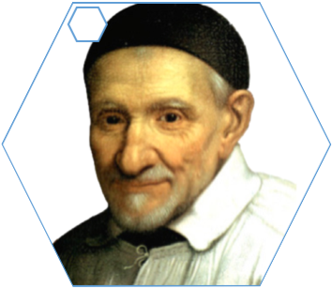
Dimensions of Formation
Notes:
We can conceptualize our Vincentian Formation in four dimensions; dimensions that encompass our human form, our gifts, our calling, and our spirit.
Briefly examine each one, beginning with Human Formation.

Slide 8
Our Vocation is Our Formation
Notes:
As we know, the primary purpose of the Society of St Vincent de Paul is the spiritual growth of its members.
We travel this pathway, this Vincentian Pathway, together.
This pathway carries us on our process of becoming…
…of becoming what?

Slide 9
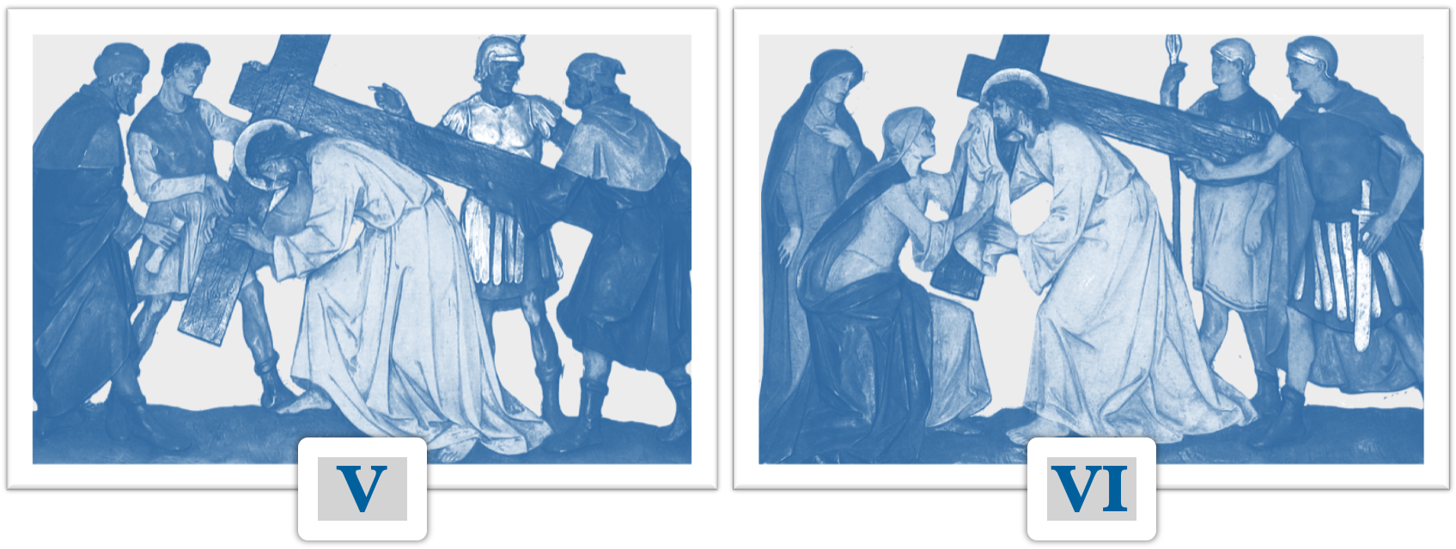
“Tu es Dominus et Deus meus”
To Serve Christ and to Share His Burdens
Notes:
Our service is a means, not an end.
Frederic reminds us that because “we see with the eyes of the flesh,” we only can see the bloodied person before us. For Frederic, the suffering of the poor was a reminder that we serve the scarred and bloodied Christ. When we see the poor man, we should therefore throw ourselves at his feet and say, with the Apostle, “Tu es Dominus, et Deus meus” – you are my Lord and Master.
Yet it is so easy to become discouraged; to know that even as we help with an electric bill, a rent payment, some food, that this family will next month face the same hardships - or worse – and we may not be there to help.
We don’t always, or even usually, change the material circumstances of those we serve in a permanent way.
It is easy to say “I did not eliminate hunger, I only gave a meal; I did not give a home, but only temporary shelter.”
But we are reminded by the Stations of the Cross that Simon of Cyrene helped bear Christ’s literal cross, and still He was nailed to it that very day;
Veronica offered a cloth for Christ to mop his face, and still he bled on the cross that very day.
We do not serve the poor merely to fix problems. We serve the poor because they ARE Christ. We serve to share their burdens for love alone; to walk with them on their via crusis.
Veronica is a Saint for having done so. We seek, through serving Christ in the same way as she did, to become…
…to become what?

Slide 10
Roles and Responsibilities
I’m a Spiritual Advisor – Now What?
Notes:
Okay, so you’re a Spiritual Advisor. Now what?
In this section, we’ll introduce you to the Spiritual Advisor Handbook, as well as a number of other specific resources for your own formation, and for your Conference.

Slide 11
The Rule
“Since the beginning of the Society, a Spiritual Advisor has been appointed to help foster spiritual life within the Conferences and Councils under the guidance of the Holy Spirit and in conformity with the Rule and Statutes of the Society.”
Notes:
Our most important resource is our Rule. Exactly what does the Rule say about Spiritual Advisors?
(Read, or have a participant read the slide, which is excerpted from Statute 15)
Ask for thoughts, and discuss:
Is this detailed or specific enough?
Does this tell you exactly what to do?
Can you think of things you might do that could be described this way?
Remember that idea of whether the Rule could be rewritten just by observing you?

Slide 12
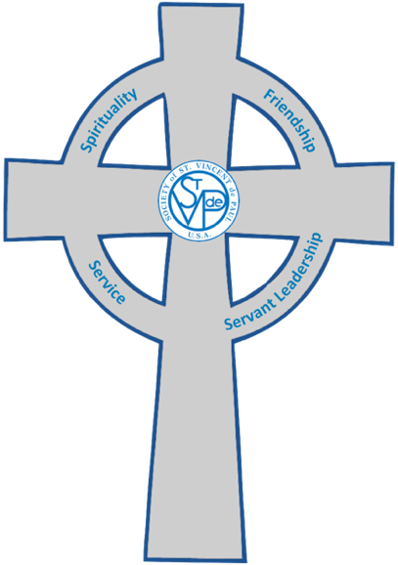
Responsibilities
Lead the Prayers and Spiritual Reflection at Conference meetings.
Collaborate with the Conference President, Council Spiritual Advisor, and Senior Formator to offer programs for formation of members.
Ensure that all meetings are conducted in a spirit of Vincentian Friendship
Mentor all Vincentians through the use of the Vincentian Pathway.
Notes:
This is the best understood aspect of the role!
Developing a formation plan is very important! SVdP offers so many, varied, and rich resources, but without a plan, we can easily overlook many of them.
As Spiritual Advisors, we sometimes act as the “conscience of the Conference,” keeping our meetings on track and in the Vincentian spirit.
The last point is related to the second; our formation plans should guide members on the Vincentian Pathway – and the Vincentian Pathway book is a great resource to help with this!

Slide 13
Planning
Conference Formation Plan
Nat’l/Reg’l Councils | Diocesan Council | Conferences
National Assembly | Ozanam Orientation | Spiritual Reflections
Invitation to Renewal | Spiritual Advisor Workshops | Conference Retreats
Getting Ahead | Leadership Workshops | Vincentian Feast Days
Poverty Institute | Home Visit Workshops | Serving in Hope
Voice of the Poor | Spiritual Retreats | Vincentian Celebrations
 | Systemic Change
 | Council Assembly
Notes:
Planning at the conference level
Review the flow from national to council to conference and show how we all work together:
National Assembly forms and informs leaders and advisors and members, the Ozanam orientation is created at the national level and deployed through each regional and council formation plan, and the conferences have available a wealth of formation and prayer materials for deployment in the conference.

Slide 14
Notes:
This concept comes from the traditional role of rules for religious orders.
One of the roles of the Spiritual Advisor is to help our Conference Meetings look like the gatherings that are described in our Rule.
Again – not to try to interpret the Rule as a set of instructions, but to consider whether its words might be written by any stranger observing your Conference.

Slide 15
Reflection
“Meetings are held in a spirit of fraternity, simplicity and Christian joy.”
✚
“Vincentians endeavor to establish relationships based on trust and friendship … They do not judge those they serve. Rather, they seek to understand them as they would a brother or sister.”
Notes:
Think of the SA role as “Spiritual Animator” and sometimes almost “conscience of the Conference”
Would an outside observer write these things to describe your Conference?
If not, how can you help influence the Conference so that they would?

Slide 16
Resources and Reflections
Spiritual Advisor Handbook and Other Resources
Notes:
Please know that it is OKAY to use Conference funds to build up your formation library, and you need to do that!

Slide 17
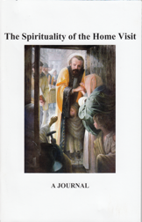
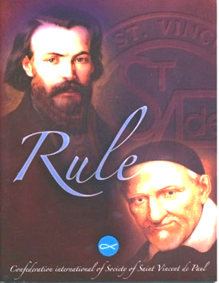
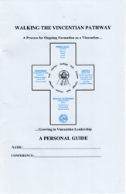
The Spiritual Advisor Handbook
Revised in 2018
A more integrated approach
Additional, practical tools
Notes:
We used the previous Spiritual Advisor Handbook for about ten years, and it is a rich collection of resources. In fact, the wealth of resources available to us is both a blessing and a burden! Especially as a new Spiritual Advisor, it is easy to be overwhelmed by it all.
We wanted to take an approach that was more integrated; presenting the information in a way that could be useful to a brand new Spiritual Advisor and a very experienced one; both a collection of resources, and a simple “how-to.”
(Have participants take each of these items out)
Other SVdP publications included with the Handbook:
Rule (pocket-size)
Vincentian Pathway: Personal and Conference versions
Vincentian Meditations – Thomas McKenna, CM
The Spirituality of the Home Visit
Serving in Hope-Module I
We’ll talk about each of these a little bit today – not just to talk about what they are, but more importantly, how you can use them; how they are meant to make your role easier!
In addition, there are a number of resources included in the Handbook itself, along with an extensive list of resources you may wish to explore on your own.

Slide 18
Member Discernment
For New Members
Introduces the Vincentian vocation; a call to grow together in spirituality, friendship, and service. Welcomes them to the journey toward holiness
For All Members
Deepens and reignites the fire in their hearts, and enables all members to live their Vincentian vocation, journeying together toward holiness
Notes:
The Handbook does not replace Ozanam Orientation!
It also does not replace the Rule, the Manual, or anything else. Think of it as the “Cliff’s Notes” version of training and formation.
Often new members are not able to attend Ozanam Orientation for a while. You might also consider giving these to prospective members, to help them discern their vocation.
And for current members, sometimes inspired by the questions from new members, the handbook is a refresher!
For the Spiritual Advisor, whose role includes helping prospective members discern their vocation, this is an ideal “all-in-one” tool.

Slide 19
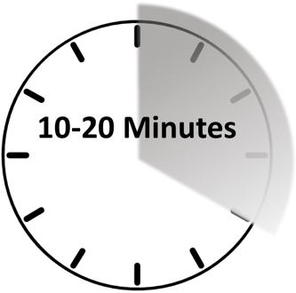
Spiritual Reflection
“…members are always invited to comment as a means of sharing their faith…”
Weekly Reflection | Serving in Hope | Apostolic Reflection
Free download Read & Reflect | Formation Vincentian Pathway | Personal Corporate
Notes:
So…if not a homily, then what?
The Rule does not give us much specific guidance about the Spiritual Reflection, but it does say that “…members are always invited to comment as a means of sharing their faith…”
It is so very important to always share our reflections together in our community of faith; to grow together in Holiness through that sharing! We share honestly, we listen openly, we grow together.
As a Spiritual Advisor, it is not your role to prepare homilies, but to encourage all members to reflect and share.
There are several excellent means for conducting the Spiritual Reflection at the meeting.
First (easiest!) is the Weekly Reflection, which you can download from SVdPUSA.org (example, and notes on how to use it, are in the Handbook.)
Open to Tab 2, P. 19 of the Handbook; discuss how to conduct this type of reflection
Second, the Serving in Hope books each include about six different sections. Each of these sections may be used as a reflection for a single meeting, or an entire module could serve as the basis for a day long Conference Retreat!
Open to Tab 2, P. 20 of the Handbook; discuss how to conduct this type of reflection
Also Tab 8
A more advanced, but very rewarding type of reflection is the Apostolic Reflection. We’ll talk in a few minutes about another tool you can use to plan for this type of reflection, but the Apostolic reflection can be a workshop all by itself!
The Handbook contains two excellent papers by Fr Hugh O’Donnell on the Apostolic Reflection – these two papers are meant to be read together:
Vincentian Discernment (Tab 12 )
Apostolic Reflection (Tab 11)

Slide 20
Spiritual Reflection
Notes:
(For best effect, stand silently for about ten seconds before saying a word!)
When we reflect together, we always follow any readings with a moment of silent reflection. It is important to remember that this “designated” moment is not the only time to welcome the silence!
When we ask members to share their own thoughts, we might be met with silence. When this happens, do not assume it is because minds and hearts are blank, or that members are not engaged. Rather, they are likely still contemplating, reaching their own understandings; listening to God.
Don’t interrupt!
Don’t be afraid of the silence.
It is in the silence that God speaks to us!

Slide 21
Vincentian Discernment & Consensus
Finding the Will of God Together
Notes:
Part of creating the “spirit of fraternity, simplicity and Christian joy” at our meetings is to move towards consensus-based decisions, based upon Vincentian Discernment.
Each of these ideas is a full workshop in itself, and this is just a very brief introduction!
Fr. Hugh O’Donnell’s papers on Vincentian Discernment and Apostolic Reflection are both included in the Handbook.

Slide 22
What is Discernment?
An Openness to God’s Will
-In me, in a unique Conference, Council, the Society
To be Led by the Spirit in Freedom
-Free to be, act, go in a certain way without resistance
A Choice between Two Goods
-Where does my body, time, money belong now?
Notes:
An openness to God’s will – Listening to the way the Spirit is present to me as a person with an unrepeatable name, in a particular unique Conference, Council, the Society.
Fr. Hugh O’Donnell, C.M.:
When God spoke your life into the world, He spoke that once and forever, never to be repeated. God has said something special in each of you and each person you serve and in each person who comes into your life. We begin to see that each person is unique and of immense value and importance.
To be led by the Spirit in freedom
“The Spirit calls us, invites us in our freedom to go in a certain direction, to act in a certain way, to be in a certain way.” (Hugh O’Donnell)
A choice between two goods - - not between good and evil, but in this choice, where do my body, time, money belong? (concrete choices, lots of options)

Slide 23
Decision-making
Rule, Part III, Statute 16: Subsidiarity and Democracy
The Society accepts the principles of subsidiarity and democratic consensus as the basic rules of its functioning.
. . .
To ensure democracy in the Society decisions are often made by consensus. Consensus decision-making requires that everyone agree with a decision, not just a majority as occurs in majority-rule processes. In consensus-based processes, people must work together to develop an agreement that is good enough, though not necessarily perfect.
In rare circumstances,
if consensus cannot be
reached, the decision may be
put to a vote.
Notes:
Rule, Part III, Statute 16: Subsidiarity and Democracy
The Society accepts the principles of subsidiarity and democratic consensus as the basic rules of its functioning.
The Catechism of the Catholic Church defines the principle of subsidiarity: “A community of a higher order should not interfere in the internal life of a community of a lower order, depriving the latter of its functions, but rather should support it in case of need and help to co-ordinate its activity with the activities of the rest of society, always with a view to the common good.” (#1883)
To ensure democracy in the Society decisions are often made by consensus. Consensus decision-making requires that everyone agree with a decision, not just a majority as occurs in majority-rule processes. In consensus-based processes, people must work together to develop an agreement that is good enough, though not necessarily perfect. In rare circumstances, if consensus cannot be reached the decision may be put to a vote.
All decisions made by a Conference or Council must be made consistent with the Rule and Statutes of the Society, Articles of Incorporation, By-Laws, and government policies of the Society.

Slide 24
What is Consensus Anyway?
Notes:
Not unanimity.
In brief, in Robert’s Rules, “general consent.”

Slide 25
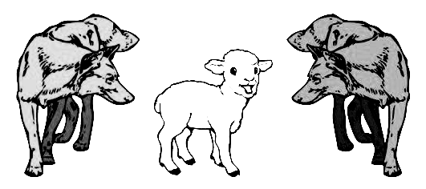
Voting vs. Consensus
Notes:
Voting is the process of abandoning our empathy, our friendship, and our community.
Voting is two wolves and a sheep deciding what to eat.
Consensus is a group of friends making plans for lunch.

Slide 26
Consensus Synthesizes Group Wisdom
Unity, not unanimity, not everybody’s first choice
Arriving at a “sense of the meeting” - something you can support, are willing to let go forward, or you “can live with it”
Value all kinds of input (rational, emotional, kinesthetic, etc…)
Notes:
Basic Principles
Same spirit with this slide. As you review the basic principles, relate to who we already say we are.
We seek unity, and that doesn’t mean everyone agrees on everything, but that we are more committed to honoring consensus and recognizing our own ego traps that we are able to find the common ground and support and accept the will of the Group that reflects our discernment of God’s will.
Value all kinds of input: We say we are all equal in the society, and that we honor the dignity of one another and those we serve. Does this show up in our actual meetings and relationships? Are some folks overpowered by others? Does everyone get a chance to speak? Do we honor the needs of different temperaments? Do we give our introverts time to process so that their wonderful ideas can emerge? Do we spend our time listening and learning or figuring out what we are going to advocate for? (Consensus is a questioning process, more than an affirming process)
This is all about the journey to integrating our aspirations for who we are becoming as Vincentians into the way we evolve conference relationships. We say we practice the Vincentian Virtue of Zeal: a passion for the flourishing of the human person. (Share, question, and learn from each other’s experience and thinking) That MEANS “lifting everyone up to their highest potential, instead of knocking down your opponents.”
As Spiritual Advisors this is the place for the integration of who we say we are spiritually with how we are with one another. An amazing opportunity for Spiritual Advisors to leverage their calling to be that non-anxious presence that gently reminds folks of who we are becoming and how we have agreed to get there by modeling Jesus, our Saints, and acting from a Vincentian Virtue based foundation

Slide 27
Consensus Synthesizes Group Wisdom
Consensus is a questioning process, more than an affirming process
Share, question, and learn from each other’s experience and thinking
Encourages lifting everyone up to their highest potential, instead of knocking down your opponents

Slide 28
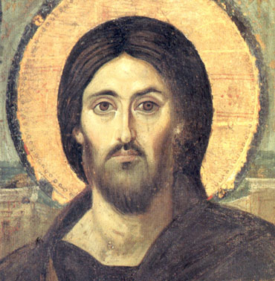
Spiritual Consensus
Facts plus Spirit’s guidance
Not majority vote, victory of the dominant, compromise
Not unanimity – all feel heard & OK
Not on your schedule
Notes:
Spiritual Consensus
Establishing consensus with the intercession of the Holy Spirit is Spiritual Consensus
Read the features
This is a radical approach to leveraging Love and Friendship and Common Mission to achieve solutions that are creative, innovative and supported by all.
Use the facts, but wait for Spirit’s guidance in regard to them
Consensus is not a democracy, but a discovery of what God wants.
Not unanimity but all feel heard & can go along with solution
God’s schedule is not my schedule – all in God’s time.

Slide 29
Closing Prayer
Heavenly Father,
Inspired by Your servants Blessed Frederic and Saint Vincent
May we bear witness to Your compassionate and liberating love
By serving Your poor cheerfully,
And each other humbly,
On our path towards Holiness in union with you, Lord Jesus. Amen.

