Slide 1
Treasurer’s Training
Taken From St. Vincent de Paul “SVdP” Conference Financial Practices Manual
Notes:
This material may not address all that your Conference needs. We hope that the requirements help to assure good practices are in place.

Slide 2
Overview
FINANCIAL RECORD KEEPING REQUIREMENTS
FINANCIAL REPORTING REQUIREMENTS
Duties of the Conference Treasurer
Safeguard and protect resources
Keep financial records (Income and Expense)
Budget and communicate the financial health of the conference
Annual Internal Audit
Notes:
This presentation generally defines the minimum requirements without specifying the processes and systems to be used.

Slide 3
FINANCIAL RECORD KEEPING REQUIREMENTS:
All Conferences are required to keep the following records:
Financial List:
List of all donations separated by type (Cash vs Non-Cash)
List of all donor's information
List of monetary assets (For example: Gift Cards)
Any additional information as required by the Society's annual audit
All documents mentioned in the “Manual of SVdP of the US”, Chapter 2, Section 2.1, & “Retention Schedule” (page 39).
IRS Form W-9 (Where rent assistance and other services are provided.)
Notes:
This overviews the requirements. More specific on Retention Schedule and W-9 requirements follow.

Slide 4
Retention Requirements
Annual Conference Report* . . . . . . . . . . . . . . . . . . . Permanent Letters of Aggregation . . . . . . . . . . . . . . . . . . . . . . . . Permanent Bank Deposits . . . . . . . . . . . . . . . . . . . . . . . . . . . . . . . . 3 Years Bank Reconciliations . . . . . . . . . . . . . . . . . . . . . . . . . . 3 Years Bank Statements. . . . . . . . . . . . . . . . . . . . . . . . . . . . . . .7 Years Cancelled Checks. . . . . . . . . . . . . . . . . . . . . . . . . . . . . 7 Years Invoices Received . . . . . . . . . . . . . . . . . . . . . . . . . . . . . 7 Years Case Records & Cards . . . . . . . . . . . . . . . . . . . . . . . . . 3 Years General Correspondence . . . . . . . . . . . . . . . . . . . . . . 3 Years Meeting Minutes . . . . . . . . . .. . . . . . . . . . . . . . . . . . . . . 7 Years Minute Books . . . . . . . .. . . . . . . . . . . . . . . . . . . . . . . . . . 7 Years Treasurer Statements . . . . . . . . . . . . . . . . . . . . . . . . . . . 7 Years *including statistics, membership list, and items with historical significance
Notes:
Records must be dated and possibly batch so that excess retention doesn’t inhibit effective retention.

Slide 5
1099 Requirements for Services and for Rent Paid Directly to Landlords
When rent payments to a landlord equal or exceed $600 in a calendar year, a Form 1099 must be mailed to the recipient and filed with the IRS.
Exceptions to this requirement:
Payments made to corporations
Payments made to real estate agents or property managers acting on behalf of a landlord.
Payments made to tax-exempt organizations (including governments)
Payments made via a third-party payment network
(credit card, debit card or PayPal type service, but this does not include online bill payments)
For Contra Costa Council, Conferences are responsible for reporting private party rent payments and getting a W-9 and forwarding to Vincentian Support Services (Steve Krank) annually. The District Council will accumulate and report the 1099s to the landlords and the IRS.
Notes:
The National Council has done considerable study on these requirement. The 1099’s report the payments made to landlords to assure that the landlord pay income tax appropriately.

Slide 6
FINANCIAL REPORTING REQUIREMENTS:
Monthly Report to Conference
Reconciled bank statements to Council for each account (monthly or annual reports as defined for your Conference)
Detailed Transaction History / Check Register or as part of Financial Functions of the Seattle DB
Copy of all checks & all deposits.
Names, addresses and total amount of donations for all donors
Notes:
The practice of keeping records of donors may also be valuable for sending thank you notes or in the event of a fund raiser.

Slide 7
Duties of the Conference Treasurer:
1. Safeguard and protect resources
2. Work with an Assistant Treasurer or other trusted member for oversight and for times when Treasurer isn’t available.
3. Keep financial records (Income and Expense)
4. Budget and communicate the financial health of the conference
5. Annual Internal Audit (“Rule”, Part III, Statutes 22 & 27)
Notes:
Budgeting” isn’t always a formal process or document, although it could be. To some extent, monthly reporting may define prospective on resources available. Audits are required by the Rule. Council audits done internally or by external auditor doesn’t assess the effectiveness of the system. That’s one “why audit?”.

Slide 8
Safeguard and Protect Resources
Ensure that the conference’s resources are protected by implementing controls (guidelines) to help protect our limited resources.
The conference must establish its own policies and procedures to regulate resources given to those we serve to reduce judgement calls and biases of members. Without proper policies and procedures, the wellbeing of the conference is at risk.
This can be a document that limits how much the conference members give to those we serve at one time, how this is tracked and how exceptions are made.
Notes:
Policies and procedures are important to guide the effective (practically fair) distribution of funds and resources).
How much can be committed by Vincentians and how are greater commitments approved.

Slide 9
Examples of documentation and records:
Check copies
Receipts for payment
Donation slips
Cash receipts for donations
Conference form for lost receipts. Have two key Vincentians sign off on this form.
Notes:
Assure that income and expenses are categorized for future reporting.
Records must be maintained with some organization. File them chronologically or my month.

Slide 10
Good Practices
Use conference bank accounts and cards. Never co-mingle funds with an outside or personal bank account.
Reimbursements must be approved and documented by an independent officer.
Make timely and consistent bank deposits. Best practice would be weekly deposits.
You MUST keep copies of deposit slips or have carbon copies of deposits. To assure that your bank records accurately.
Never give checks or cash directly to those we serve. Note: Check fraud has been an issue where checks have been modified, copied, etc.
Do not use pay apps.
Notes:
All five of these practices are addressing situations that have occurred in our Contra Costa District.

Slide 11
Good Practices
Using gift cards and vouchers, track each gift card by keeping an accounting journal of each card purchased or donated to the conference.
Label each card and/or track the serial number of each card and track each gift card that has been distributed.
Gift cards are only to be used to help those in need. Protect and secure the gift cards and vouchers.
Do not use gift cards internally to substitute for a check.
Never collect donations for another nonprofit’s organizational purpose outside of SVdP. a. “Rule”, Part III, Statute 26
Never fund an organization outside of the Vincentian family – rare exceptions.
Reconcile/balance financial accounts every month.
Bank accounts
Gift card and or Vouchers
Review monthly reports and accounting records. The President may institute an audit of records at any time or may review records themselves. (“Rule”, Part III, Statute 27)
Notes:
Periodic audits verify that you have effective practices that are being followed.
There are situations where funding a joint venture is possible, they require considerable engagement of Vincentians and the neighbors that we serve.
Monthly reporting to the Conference assure that accounting is being done as the Conference reviews the outcomes.

Slide 12
Take an annual inventory of goods.
Year-end is September 30. Inventory counting on or near this date. Assets:
Gift Cards
Vouchers (Does not include fixed assets like desks, computers etc.)
Optional inventory count:
Non-cash goods
Food (by weight)
Clothing
Donated Furniture, household goods
Hygiene and other products
Notes:
Gift cards and vouchers must be inventoried. In-kind food, furniture, and clothing, etc. is not always critical to inventory.

Slide 13
Keep Financial Records
Income (kept on a log or in Seattle DB)
Cash and checks
recorded per transaction, and deposited.
Date
Name
Address
Restrictions for use
Notes:
Restrictions on donations can be separated in the Seattle DB or by other means.

Slide 14
Grants
Applications should be reviewed or sent to the council prior to submission and to make sure no other conferences have applied already.
Document grants applied for and received.
Grants received must be documented on the conference’s log or Seattle DB.
Note any restrictions or categorization.
Notes:
Grantors often limit grant request to one for each ID – we share that ID as part of the 501(C)3 corporation we share.

Slide 15
Expenses – Categorized at Expenditure
Cash
A no cash policy is best (hard to track, easy to be lost)
Keep receipts. Use substitute form if lost.
At least one officer must approve all cash purchases – or as defined
Record the transaction
Checks
bank statement should show images or keep details of the check.
Checks of $XX or more” must be approved and documented by two independent signers.
A log must be kept or Seattle Financial DB
Have approved and keep a record of the approval (email or paper works)
Keep receipts. (Use substitute form if lost)
Store checkbooks in a secure area.
Careful on signing blank checks. At least include the payee.
Never give checks to those we serve.
Mail or deliver checks directly to the Payee
Notes:
Authorities for expenditures and signing checks must be defined.

Slide 16
Other Pay – Categorized
ACH/Debit
Debit cards. Limit access.
Limit spending thresholds or vendors where they may be used.
Limit signers. Keep all receipts.
Use substitute form if lost. Sample form on next slide.
Keep Secure.
Limit automatic transactions.
Do not electronically store the conference’s financially sensitive data in computers accessible to others. (logins, bank account number, etc.). For example, when your computer says, do you want to save passwords, NO!
Notes:
Checks provide more controls over expenditures and approvals. Here are some ideas around Debit cards.

Slide 17
Sample Form
Lost Receipt Form
Conference:
Date:
Receipt | [Name]
For: | [Company Name]
 | [Street Address]
 | [City, ST ZIP Code]
 | [Phone]
Qty | Item # | Description |  | Unit Price | Discount | Line Total
Notes:
Another example included the method of payment: cash, check or credit card.

Slide 18
Other Transactions– Categorized
Credit Cards (CC)
Limit access
Limit line of credit options and spend thresholds
Limit users and who can have a credit card
Keep all receipts
In your accounting software the CC must be listed on your balance sheet. Itemize large purchases.
The transaction cannot be listed and paid separately as a bank transaction.
Notes:
Transparency is a great practice.
Regular review of transactions is valuable even if the card wasn’t known to have been used.

Slide 19
Income and Expenses Best Practices
Keep up with the accounting, enter transaction into log or Seattle DB as received or spent - Not based on bank statements
Do not retain checks or cash. Try not to duplicate processes.
Our primary mission AND accounting is part of the responsibility of the conference. Ask, “Is there a better way to do this and does this follow the conference guidelines?”
Have an internal audit at least once annually. Use this to audit, improve and reflect.
If your parish directly hands over individual cash and checks, then these need to be documented as individual donations given directly to the Conference. The income would be recorded as ‘Church Poor Box’. If you receive miscellaneous donations directly from parishioners this is miscellaneous revenue.
If the parish provides one check , the donor is the church. Request details of the donations.

Slide 20
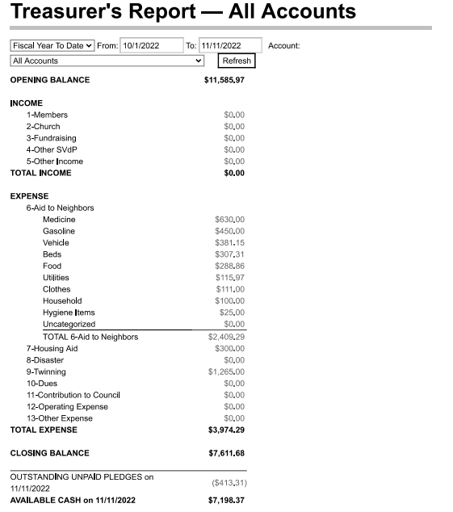
Notes:
Sample report from the Seattle DB

Slide 21
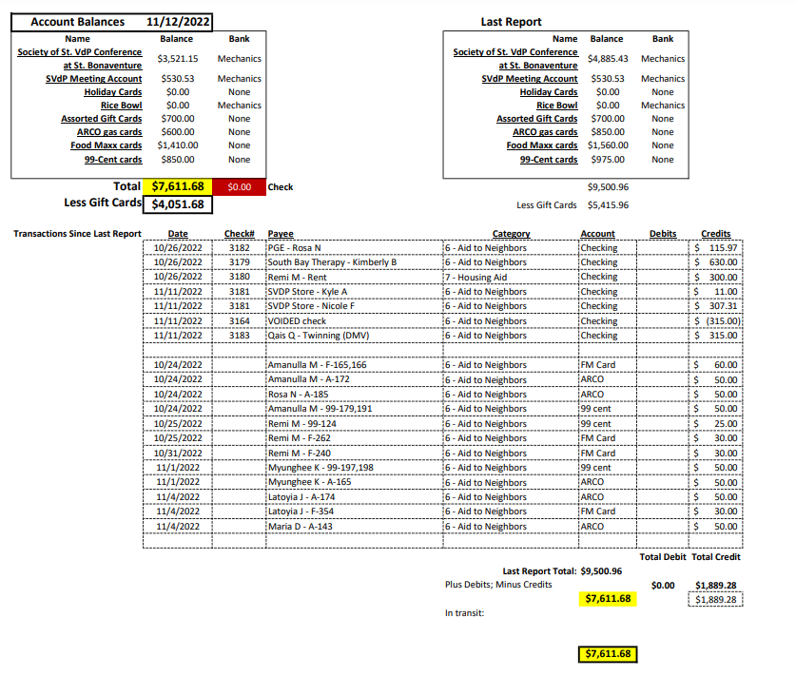
Notes:
Assembled this report from tables in the Seattle Database.

Slide 22
Accounting notes
The starting balance of the financial year should be the ending balance of the prior year – unless exceptions as identified.
Recognize Twinning checks different than donations. The donor Conference reports the Twinning as Twinning and the receiving Conference reports the expense as service.
Voided checks should be reversed from your balance. System entries would be payee is “void check” and the amount recorded as a negative number equal to the voided check.
We highly recommend using the Seattle Data Base for service records and the accounting functions. Demonstrations of the DB can be shown at the end of the presentation or whenever you request.
Notes:
We could include a number of screen shots of the Seattle DB or a live demonstration could be done.

Slide 23
Reminder
You may have to be stern as a treasurer.
Set a tone early and guard conference funds.
Some don’t understand/value treasurer’s obligations.
You may have to demand receipts.
Document uncompliant members or situations and report this to the conference president
Contact Vincentian Support, Executive Director and/or Council President if you have any major concerns or issues. Especially issues pertaining to fraud, theft or unethical behavior

