Slide 1

Annual Special Works Report
St. Vincent de Paul of Contra Costa County
Pat Walsh
August 5, 2024

Slide 2
Agenda
Introductions
What is the Annual Special Works Report?
How to Complete the Form
Next Steps

Slide 3
Introductions
Share your name, conference, and how many years you have served in St. Vincent de Paul
What is your favorite flavor of ice cream?

Slide 4
What is the Annual Special Works Report?
A Special Work is something you devote a special location and people resources all year around. Otherwise, it is considered a project.
For many of us, our Food Pantry qualifies as a Special Work.
Other Special Works include Auto Programs, Dental Services, Dining Rooms, Medical Services, Shelters, etc.
Normal Conference work (such as home visits, paying rents and utilities, delivering groceries, etc.) is not a special work.
The Annual Special Works Report quantifies our assistance.

Slide 5
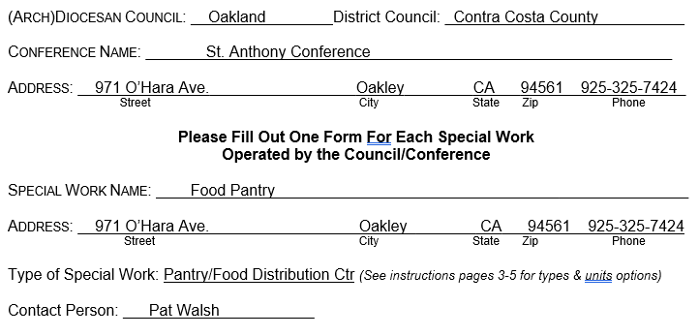
Completing the Form
Instructions can be found on Page 3.

Slide 6
Volunteer Hours
From the instructions (pg. 3): Enter the number of hours worked by volunteers – whether they are members, court ordered community service, community volunteers, etc. This statistic is already included in the main Conference Report.
Use the Seattle Database
Estimate the number based upon your best thinking about the number of “person hours” associated with your food pantry
Sign-in sheets for volunteers can help
Consider the hours spent
  Gathering
  Organizing
  Serving food
  Cleaning up

Slide 7
Number of Neighbors in Need Served
From the instructions (pg. 4): Enter the number of people who benefitted from the service provided by this Special Work. This statistic is already included in the main Conference Report.
Use the Seattle Database
Estimate the number based upon your best thinking about the number of neighbors in need served
Sign-in sheets for neighbors being served can help

Slide 8
Unit of Service 1, 2, 3 (Depends on Type of Special Work)
From the instructions (pg. 4):
Units of Service 1, 2, 3: The “units of service” (US1, US2, and US3) is a measurable count of the product or service provided by the Special Work. It has a different meaning with each type of Special Work. Please refer to the description below:
Pantry/Food Distribution Ctr:
US1 is number of boxes/bags of food distributed
US2 is weight (in pounds) of food distributed
US3 is the percent of distributed food that was purchased.

Slide 9
US1
Estimate (Use Seattle Database)
How many people did you serve in the year?
How many bags/boxes does each person receive?
Multiply

Slide 10
US2
Weight in lbs. of food distributed
Use Seattle Database
Estimate and multiply

Slide 11
US3
Percent of distributed food that was purchased
Estimate

Slide 12
Value of Direct Service
From the instructions (pg. 5):
Dollars for Direct Service: Enter the total funds that were used as direct service for those in need. For example, if the service of this Special Work included rent, utilities, bus passes, laundry tokens, etc., the amount spent for this direct aid should be entered here. This value is already included in the main Conference Report.
Estimate

Slide 13
Total Operational Costs
From the instructions (pg. 5):
Operational Costs: Enter the total of all other operating expenses for this Special Work. This value is already included in the main Conference Report.

Slide 14
Value of In-Kind Goods
From the instructions (pg. 5):
Value of In-Kind Goods: In-Kind goods includes items (such as food, clothing, furniture, etc.) that are donated at no cost to the Society and given directly to someone in need or put into use by the Society. Enter the estimated value of this merchandise. This value is already included in the main Conference Report.

Slide 15
Value of In-Kind Services
From the instructions (pg. 5):
Value of In-Kind Services: In-Kind Services includes services (such as legal, medical, dental, etc.) that are donated at no cost to the Society and provided directly to someone in need or to the Society. Enter the estimated value of these services. This value is already included in the main Conference Report.

Slide 16
Questions?

Slide 17

Thank you!
“We should spend as much time in thanking God for his benefits as we do in asking him for them.”
~St. Vincent de Paul
Pat Walsh
pmwalsh@aol.com
760-636-6569

