Slide 1

Season Of Sharing Training 2025

Slide 2

AGENDA
Introduction
Brief history of the fund
Eligibility Criteria
The new application
The Crisis
Proof of the crisis
Payments not covered by SOS
Critical Needs
Questions

Slide 3

Season of Sharing Program
In 1986, the Evelyn and Walter Haas, Jr. Fund co-founder, Walter A. Haas, Jr., and the Fund’s President, Ira Hirschfield, approached the San Francisco Chronicle with an idea: the Bay Area needed a charitable fund to help individuals and families in crisis.
Since our founding, the Chronicle Season of Sharing Fund has distributed $185 million, comprising $156 million in housing and critical needs assistance and $29 million in food assistance. These funds have gone to assist tens of thousands of households across the nine counties of the San Francisco Bay Area — Alameda, Contra Costa, Marin, Napa, San Francisco, San Mateo, Santa Clara, Solano, and Sonoma.

Slide 4

New eligibility criteria
ELIGIBILITY
Current resident of one of the nine counties of the San Francisco Bay Area (Some counties have residency minimums-see specific county requirements).
Has not received assistance from Season of Sharing Fund in the last five years (this includes Covid-19 assistance).
At risk of experiencing homelessness or housing instability, or currently homeless.
Primary applicant is 18 years of age or older.
Experiencing an emergency, crisis, or an unexpected event for which financial assistance is needed to maintain or improve household stability
REQUIREMENTS
Residents of Contra Costa County for at least 3 months.
The household experience a recent, unexpected loss of income resulting in difficulty paying rent.
Forced to moved asking for deposit and first month (low-income household) The applicants must present proof of enough income to pay future rent
All applicants must be screened for eligibility to apply for SOS at: sos@ehsd.cccounty.us

Slide 5

Why we have a new application
The Season of Sharing Fund Board of Directors has implemented this change. In dropping the priority population requirement, they have created a NEW SOS APPLICATION form to collect data on homelessness prevention in Contra Costa County.
The new form is a little bit longer, but the data collected will be very helpful. We are implementing this new fillable form immediately and ask that you begin using this form now.
Please do not alter the application in any way

Slide 6

The new application
Eligibility Screening
Emergency Assistance Requested
Applicant Information, and Housing status
Additional Applicant Information
Household Information
Additional Household Information
Landlord/Vendor Information

Slide 7
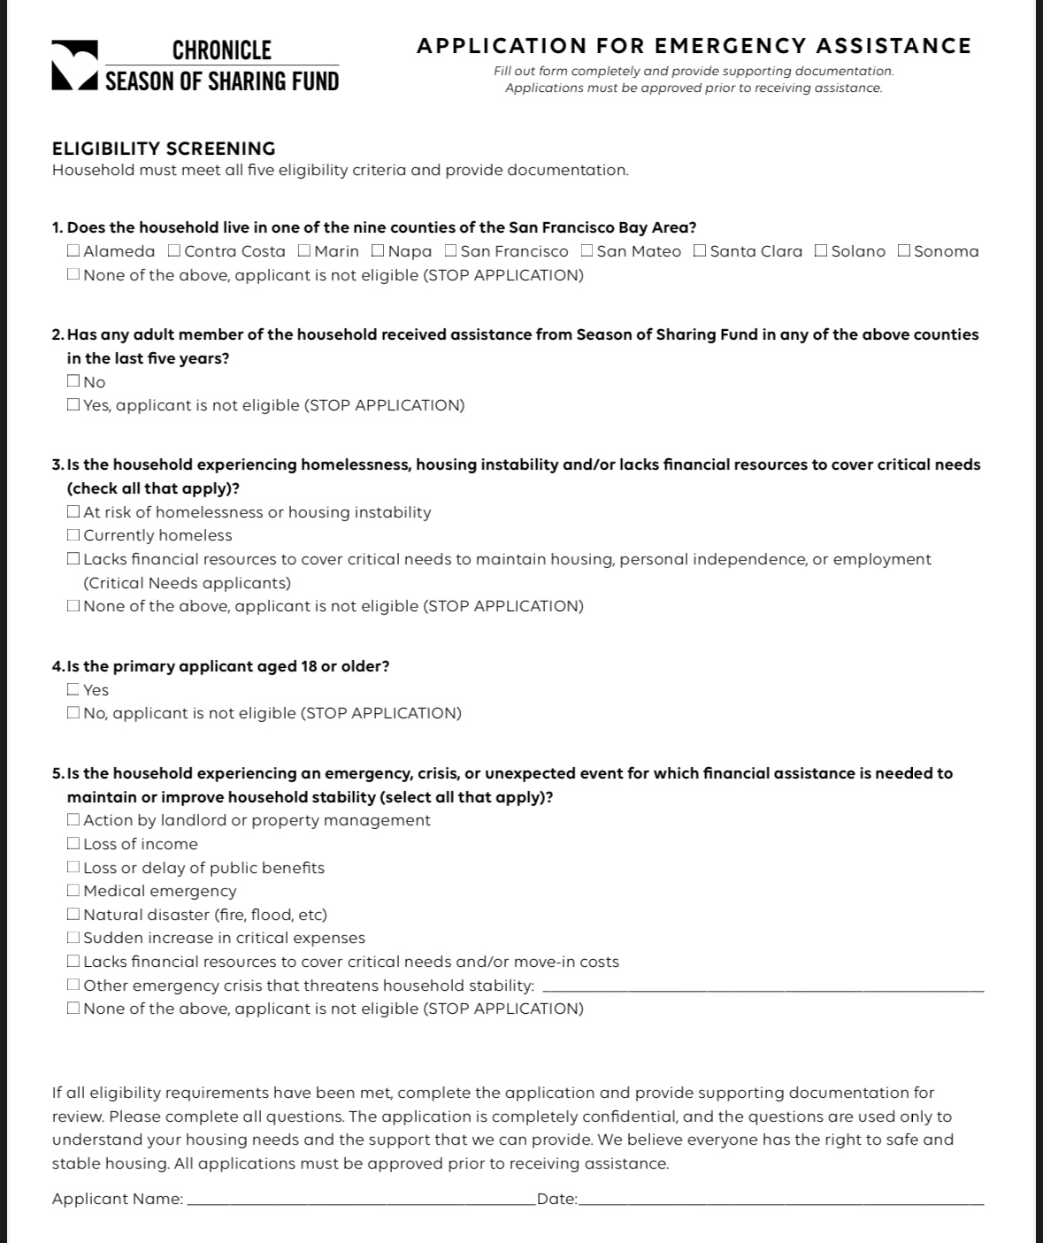


If the applicant is coming from one of the other 8 Bay Area Counties, they need to present proof of at least 2 months residing in CoCo County; if they are coming from a different county out of the 9, they must provide proof of being a Contra Costa Residents for at least 3 months
Please contact sos@ehsd.cccounty.us by mail BEFORE you start filling the application.
Ask the clients if they can provide proof of their crisis, if they cannot, please do not take the application.

Slide 8
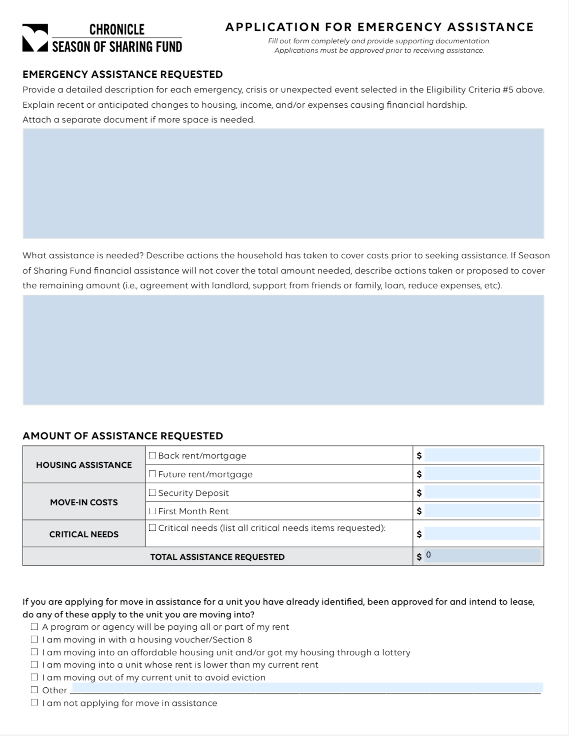


Please describe Why the applicants need help.
Employment or Income loss, work hours reduction
Natural emergency or disaster (fire, flood…)
Medical Emergencies, hospitalization, temporary disability
Paid medical bills
Workers-comp, laid off, loss of benefits
Death or divorce – separation certificate
Unexpected expenses, new financial responsibility
Elder abuse, domestic violence forcing to move
Landlord initiated 30, 60, 90 days notice
Crisis must be out of the client’s control or fault.

Slide 9
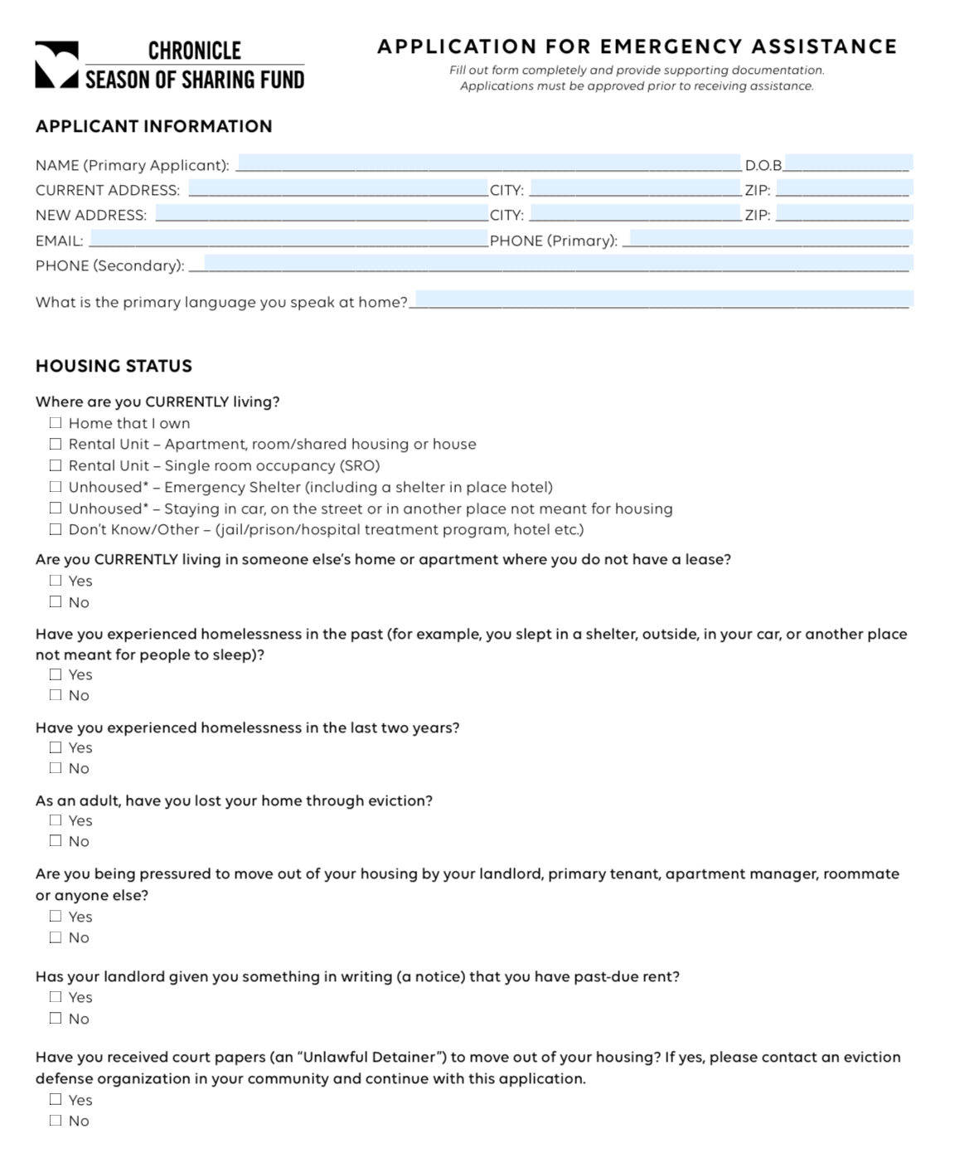

Please don’t forget to add the worker & client’s email
Don’t forget to answer all the questions
Page 3

Slide 10
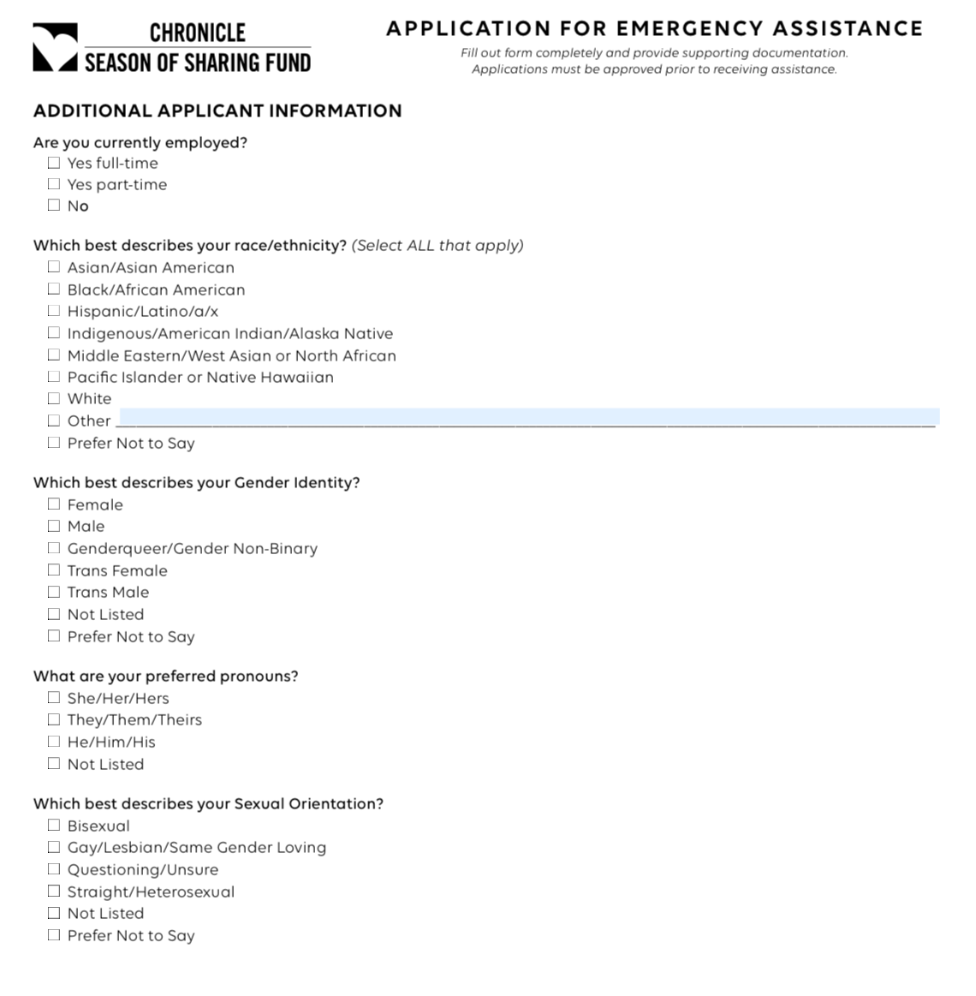

Please explain
the clients
the reason why
we are asking
this questions

Slide 11
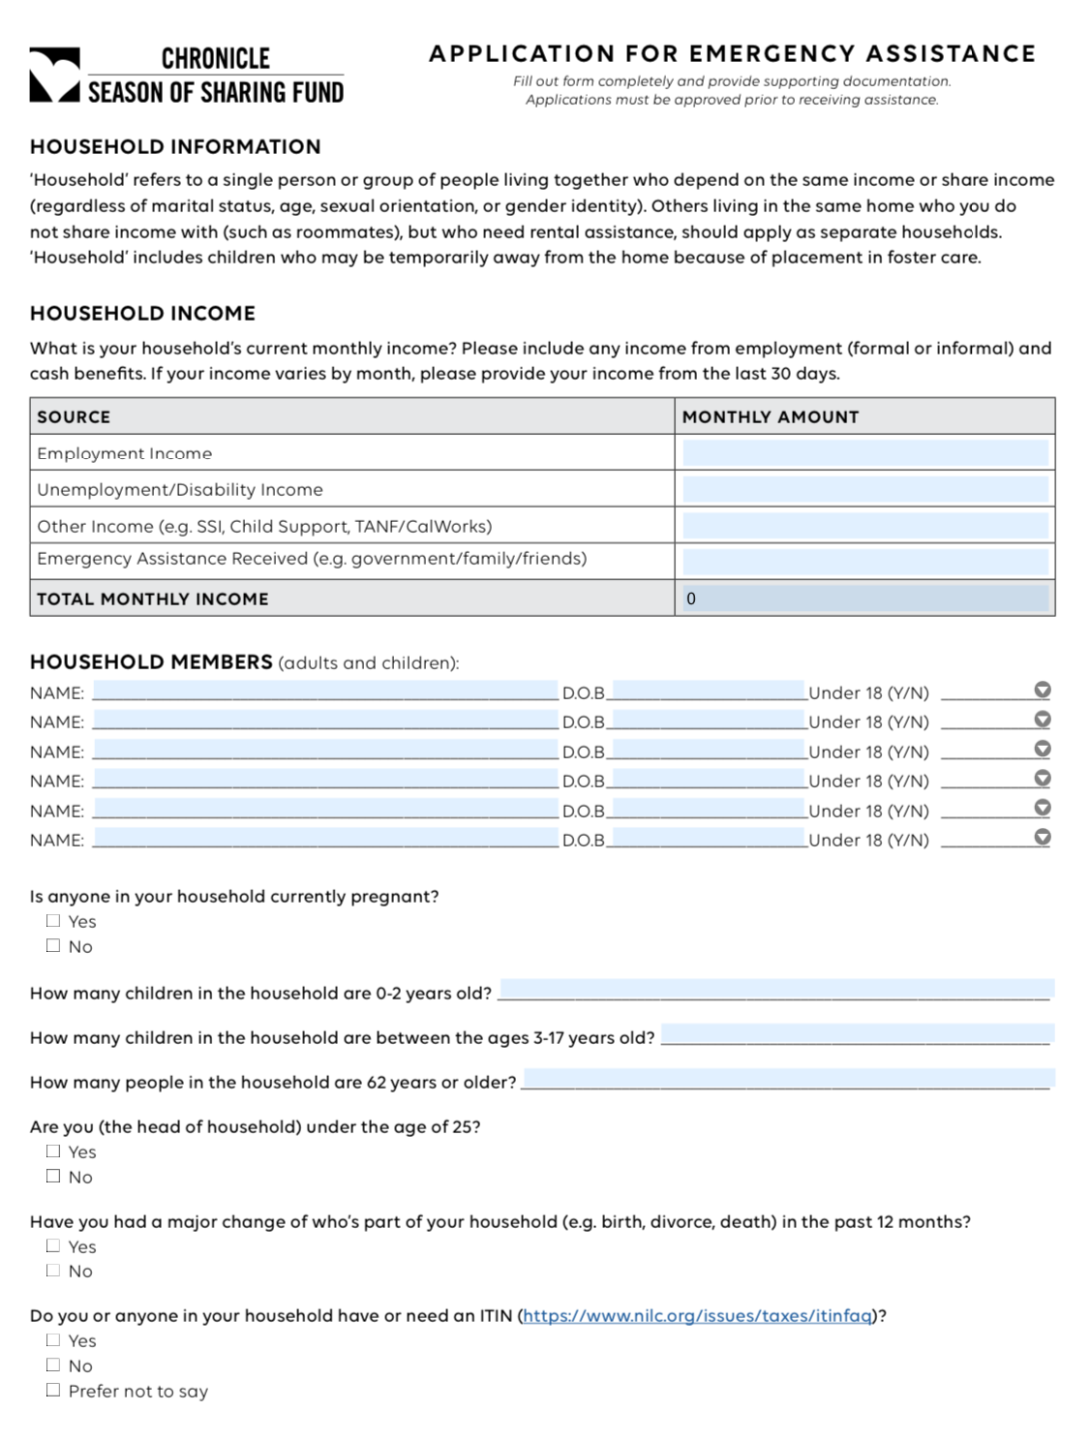


Please complete the budget portion
Add all the members of the family
Complete all the answers

Slide 12
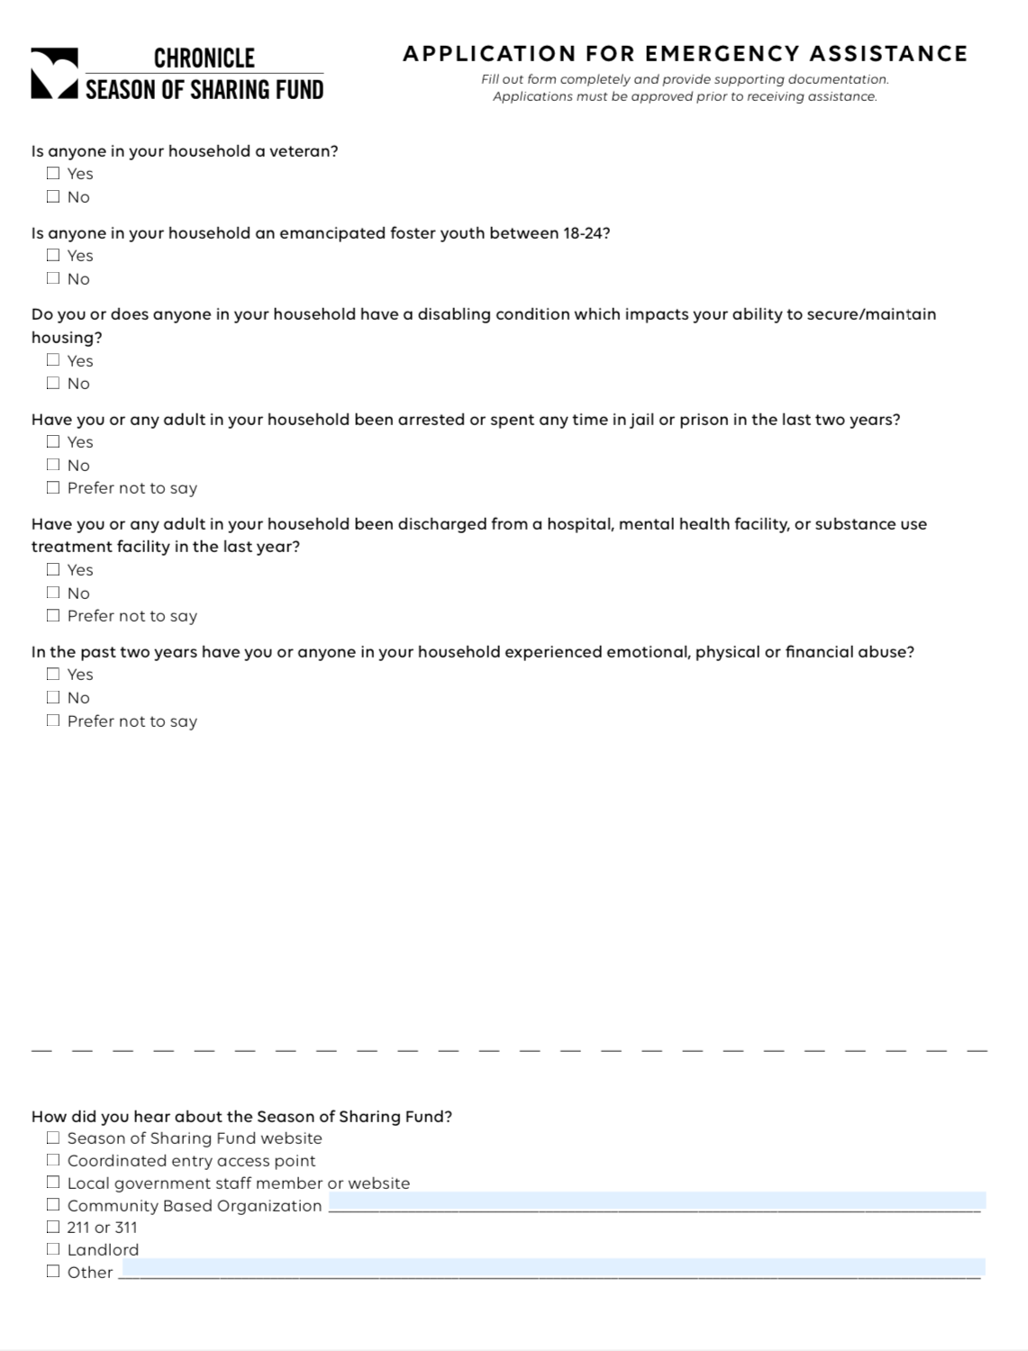

Please answer all
this questions

Slide 13
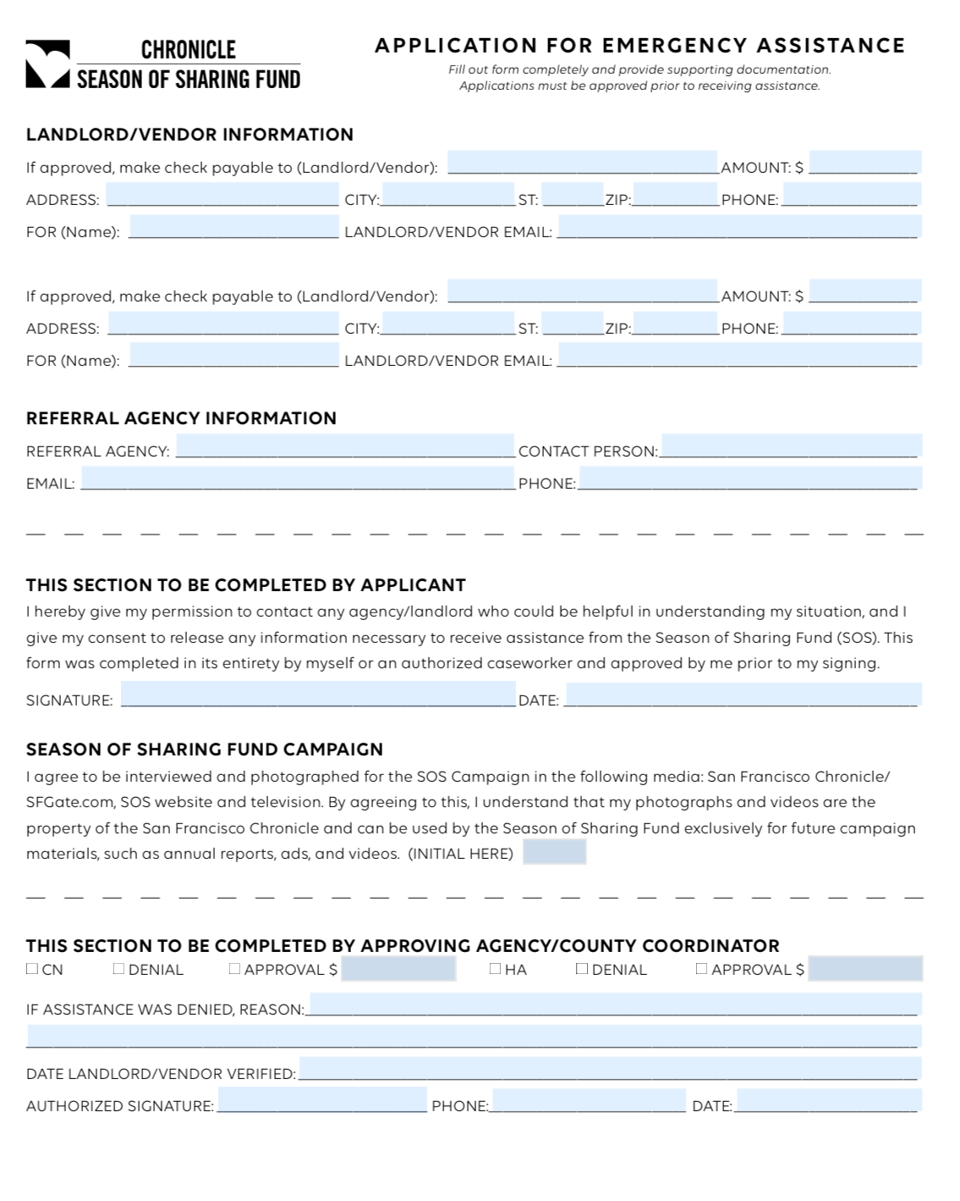
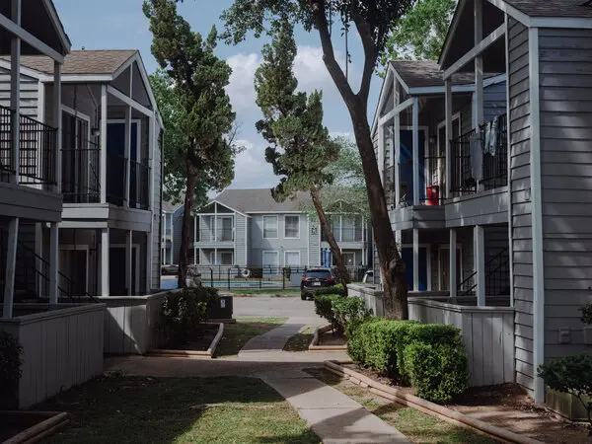

Please don’t forget to add the landlord’s information including the email
Request the W9 for all landlords and Vendors including Banks, corporations, no exceptions
The referral agency is You!
We do not help with subleased properties.
The applicant must be one of the tenants on the lease

Slide 14


Proof of the crisis
Income loss
Disability, Medical bills paid
Fire, Flood, natural emergencies
Divorce, family separation, dead
Laid off, end of employment,
Need to move to a new place
End of homelessness

Slide 15

Important remarks
The check will be sent by mail to the services provider. It will take a couple of weeks to arrive
The program pay Deposit or Rent. Only for low- income applicants the program will cover both.
Once the applicant is approved for any amount they cannot apply until 5 full years had passed.
The help for old Covid debts ended.
Please submit the full application to sos@ehsd.cccounty.us
A letter explaining the situation of the client is needed , but it is not going to be considered proof of the crisis
Please don’t submit pictures.
We only help with deposit or 1 month of delinquent rent for Section 8

Slide 16

Examples of Expenses
NOT Covered by SOS
Educational tuition or school supplies.
Clothing.
Property taxes.
Home modifications or repairs.
Homeowner association fees.
Home maintenance or late fees.
Phone bills.
Appliances such as washers and dryers.
Movers or moving trucks.
Storage.
Hotel/motel bills.
Food.
Funeral expenses.
Airline tickets or travel expenses.
Repayment of payday loans or personal loans to friends or relatives.
Court costs or legal fees.
Routine medications or doctor visits.
Parking tickets, speeding tickets, impound or towing costs.
Gas, automobile registration.
Down payments or deposits for automobiles.
Legal fees.
Credit card bills.

Slide 17



Critical Needs rules
Critical Needs include emergency costs determined necessary to maintain housing, personal independence, or employment, which are not covered by insurance or other sources and have not yet been expended. Eligible uses of Critical Needs assistance include:
Essential furniture in response to an emergency.
Beds and dining set consisting of mattress and simple frame; no bed furniture such as headboard, footboard, etc.
Medical equipment and health aids that are critical for maintaining a job, obtaining employment, continuing school, or maintaining independence.
  Medical equipment includes respiratory equipment, wheelchairs, wheelchair batteries, walkers, and some motorized chairs, etc.
  Health aids including hearing aids, eyeglasses, etc.
Critical dental costs. (Primarily for seniors or a verifiable medical need that impacts housing stability.)
The maximum amount is $3000 or combine with housing $5000

Slide 18
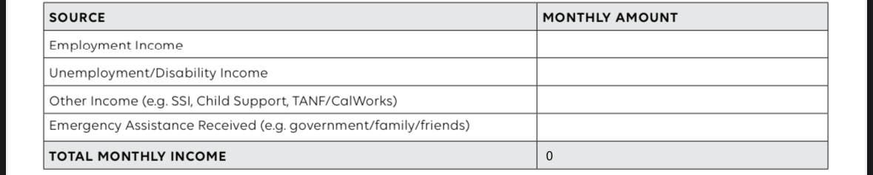
Please Do not forget!
  We need Picture ID for all the main applicants
  Do not alter the application in any way.
  Undocumented applicants are welcome, but they need to have also picture ID
  Don’t forget to fulfil the new budget portion on the application

Slide 19
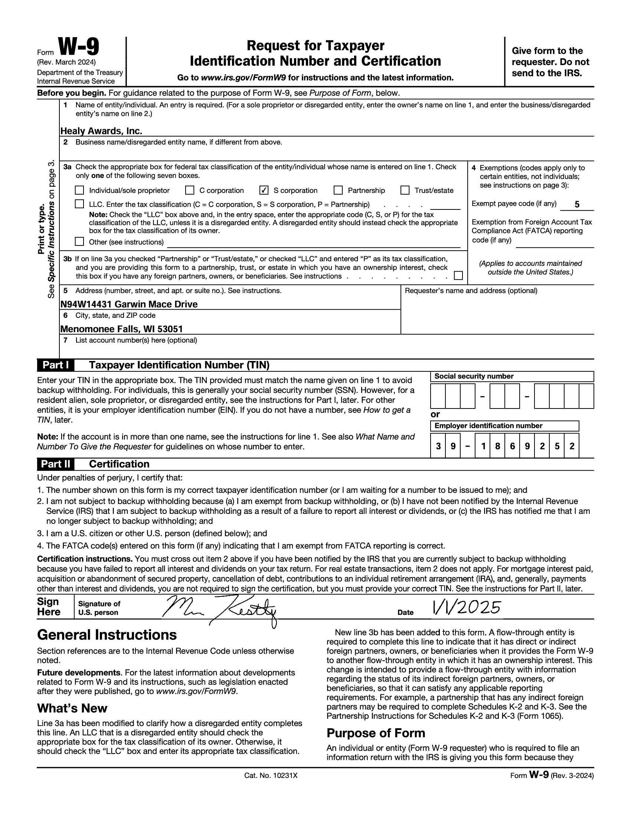
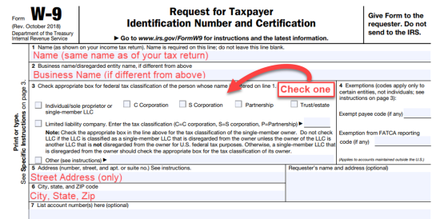
W-9 Form
For IRS norms, we required a W-9 form filled by the landlord with all the information listed.
The lack of this document before the 4pm on Thursday will delay the check 1 week
Please send 1 with the application, or the landlord can send it directly to our email sos@ehsd.cccounty.us

Slide 21
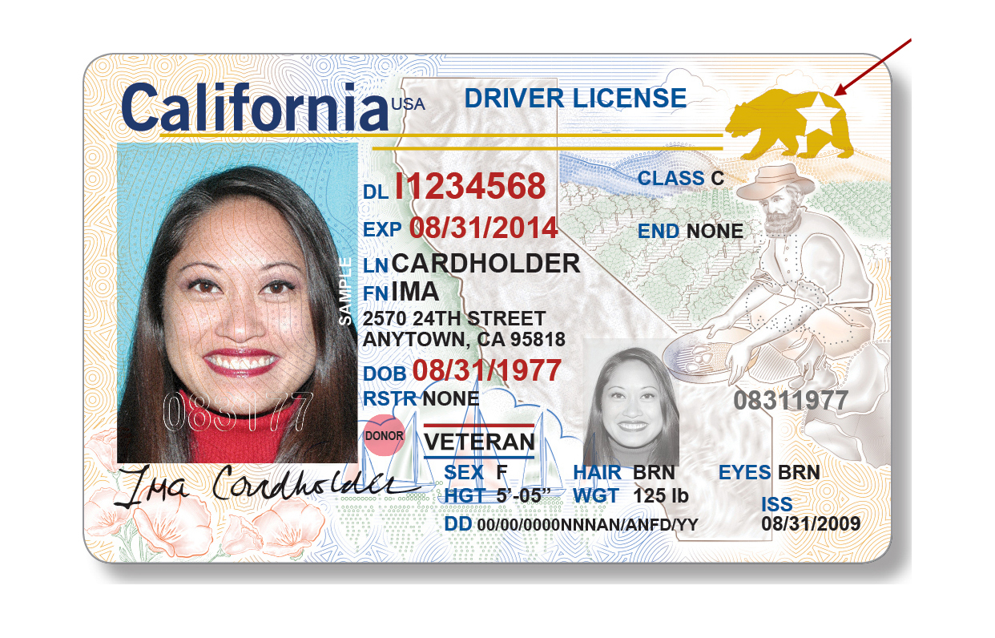




Slide 22


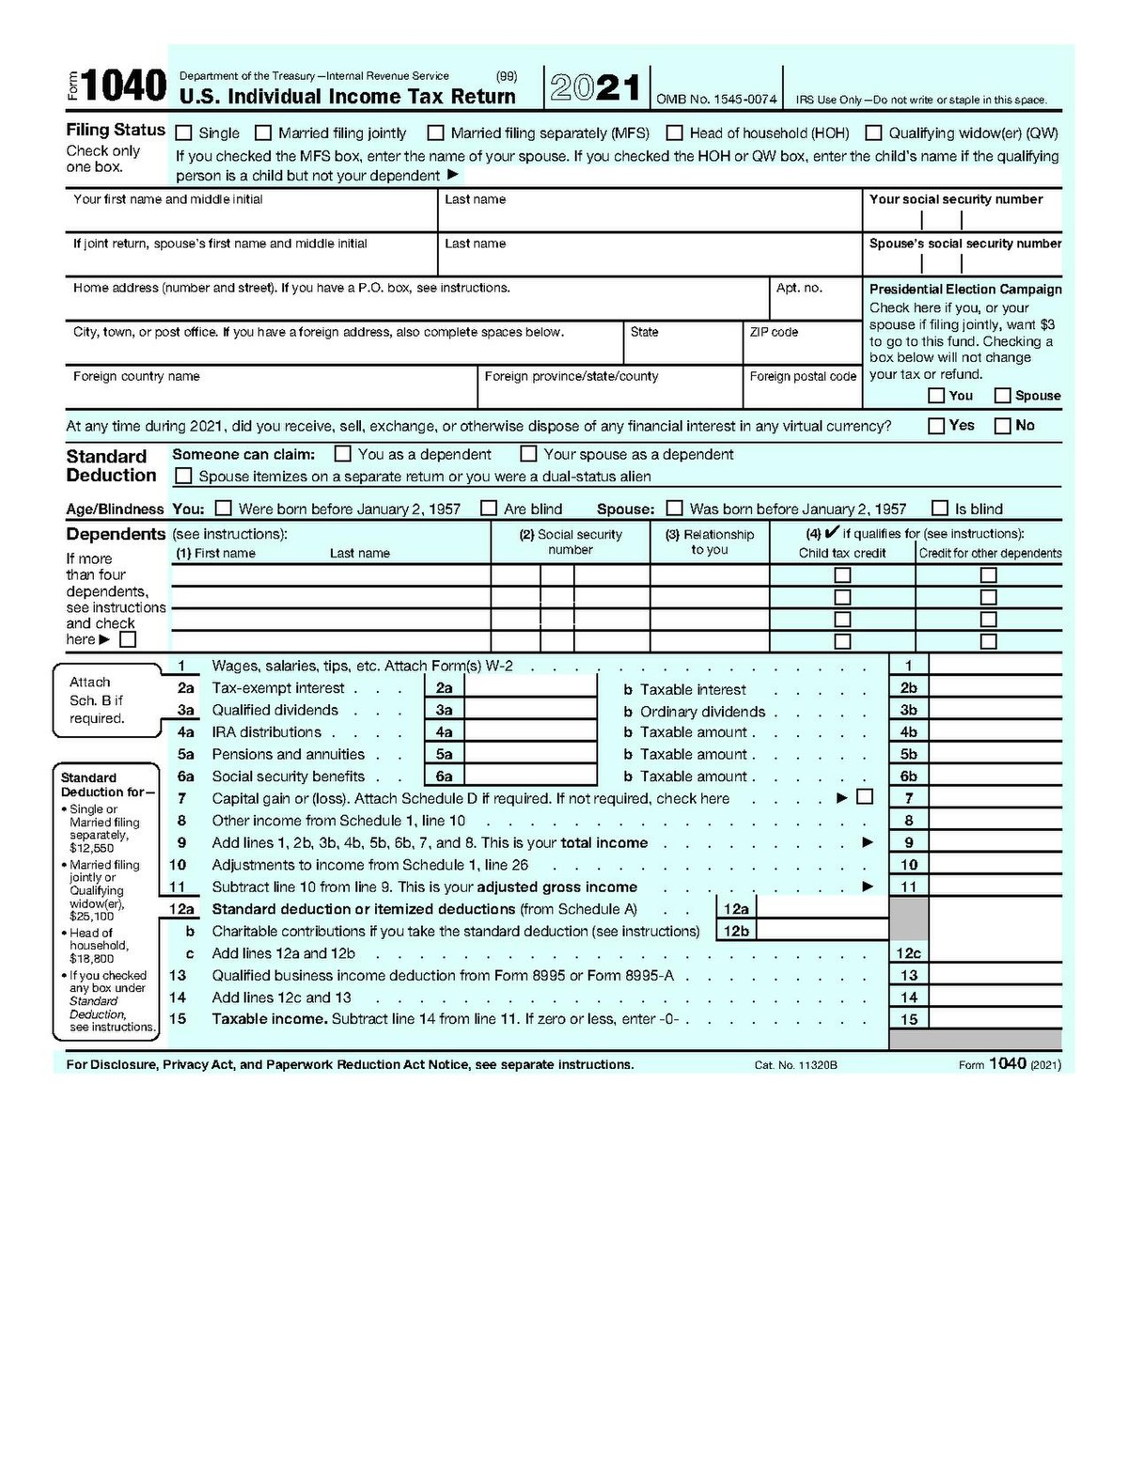


Slide 23


Slide 24


Slide 25

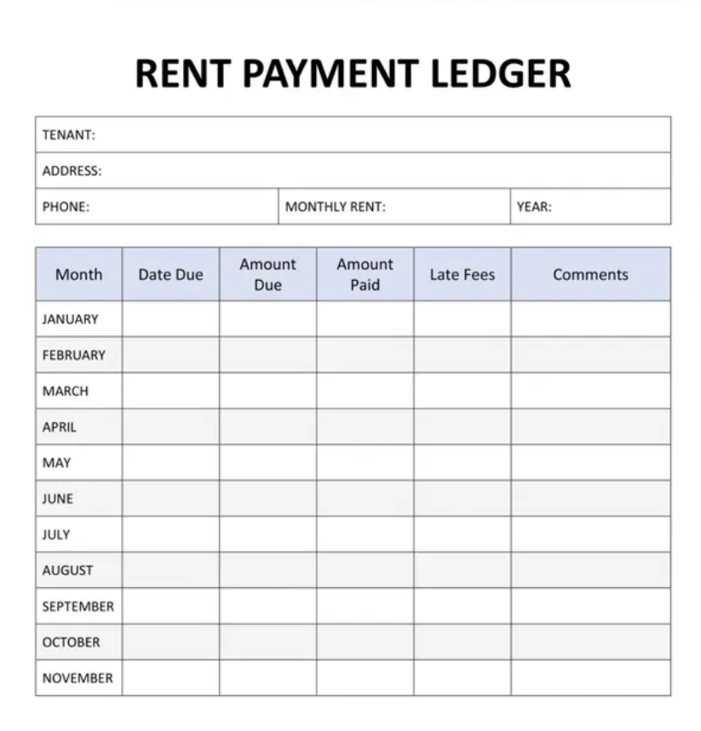

Slide 26


Slide 27

THANK YOU
Contra Costa Season of Sharing

