Slide 1


Slide 2

Tools for the Home Visit
Presented by:
SVdP Hope Conference
May 31, 2025

Slide 3

Introduction

Slide 4
In Dedication
to
Dick Gilpin and Gwen Watson
In company with Christ,
Who died and now lives,
may they rejoice in Your kingdom,
where all our tears are wiped away.
Unite us together again in one family,
to sing Your praise forever and ever.

Slide 5
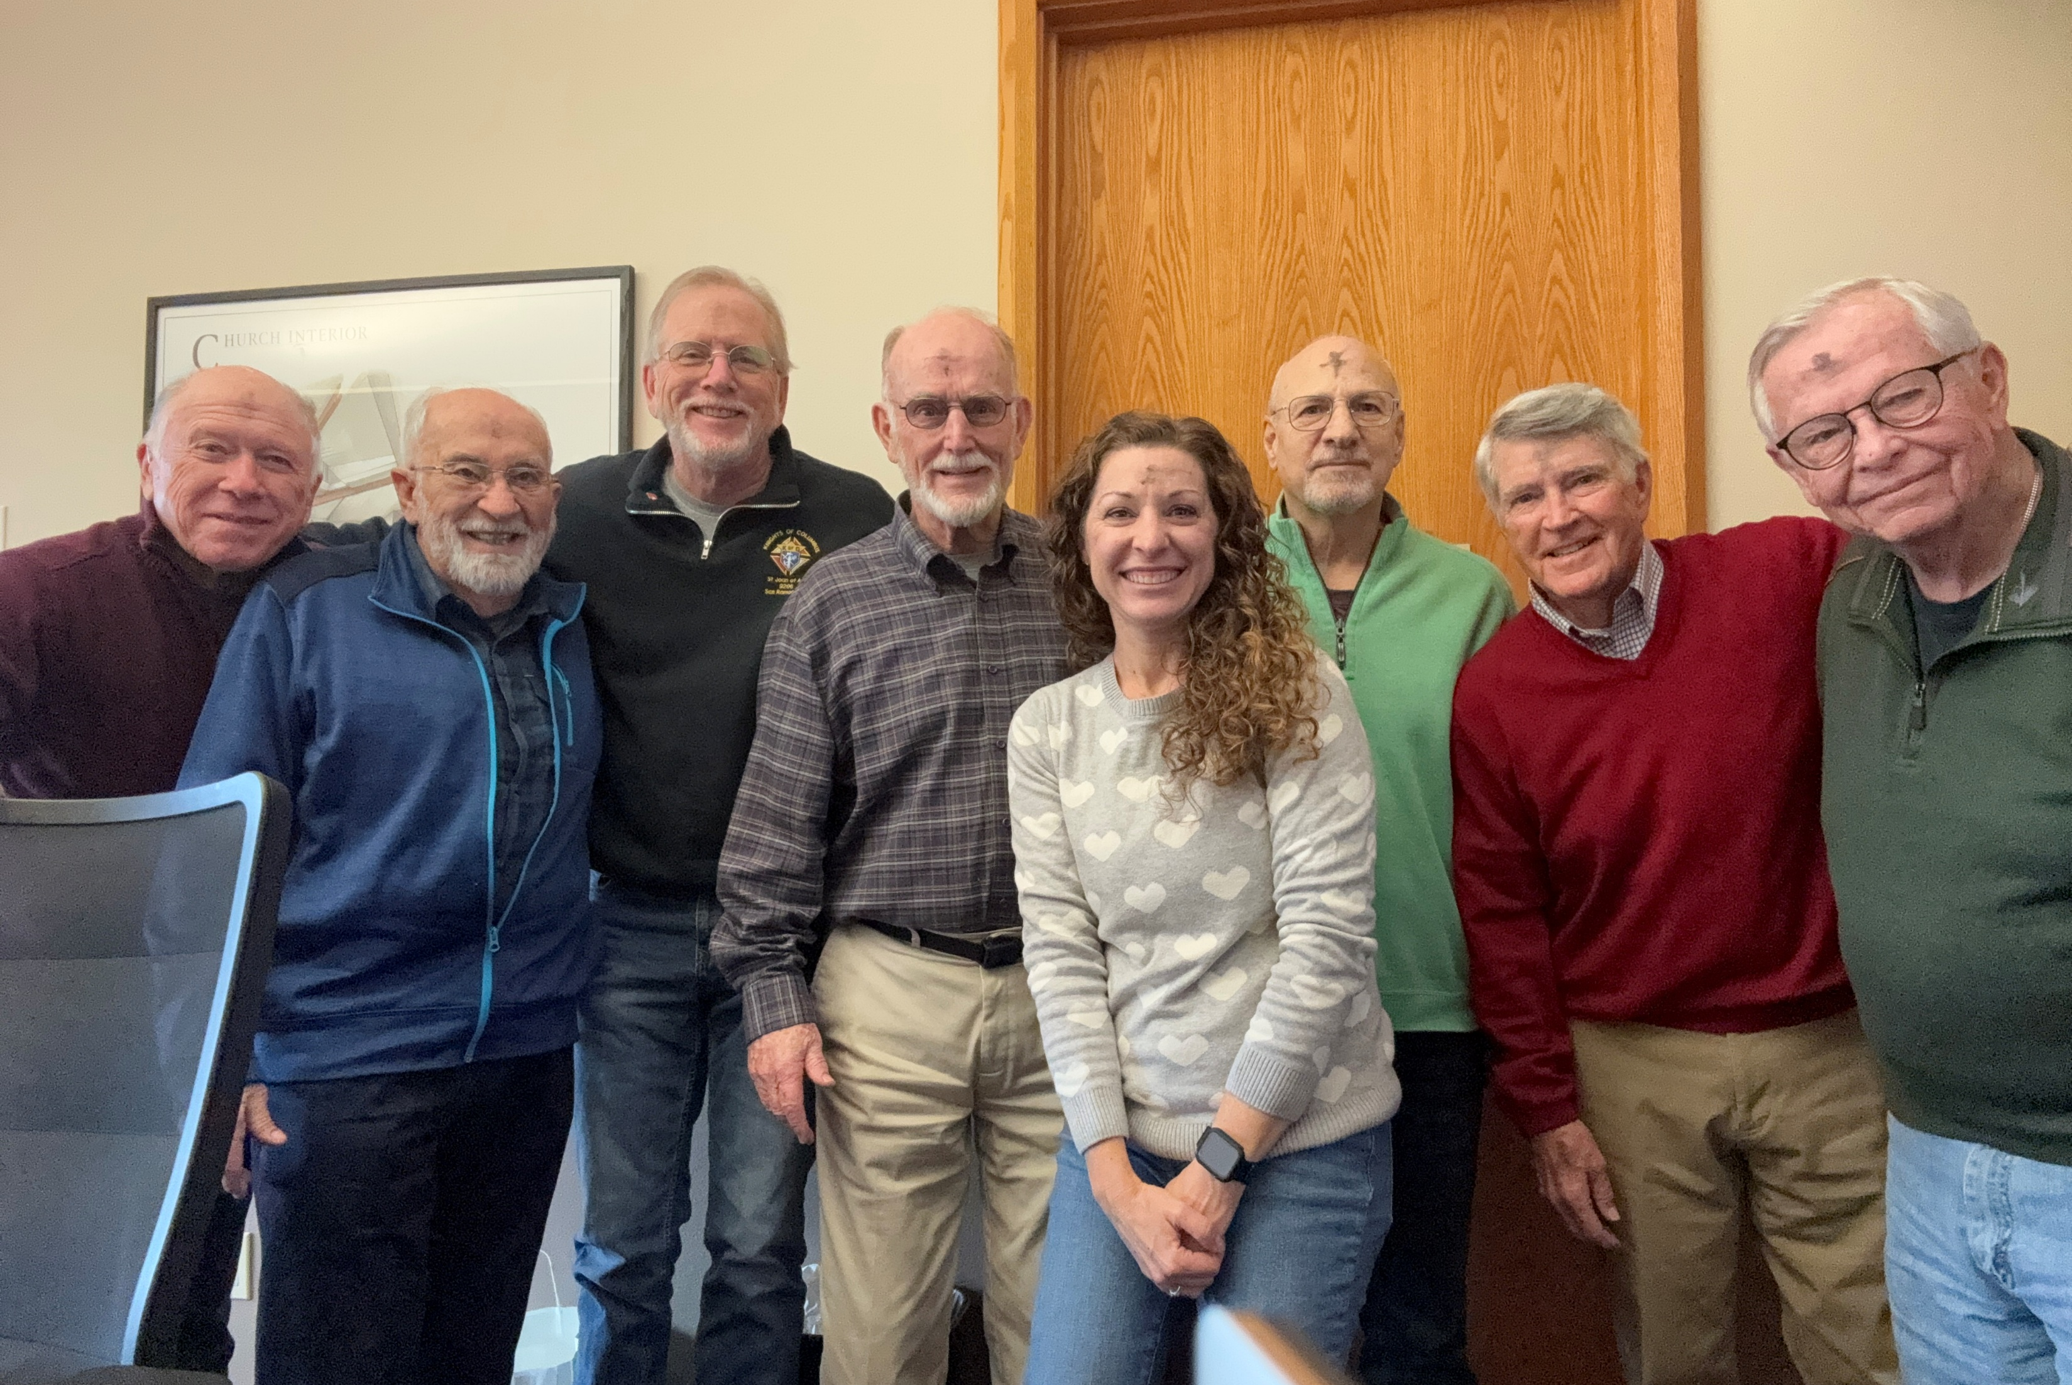
Joe Rivello
John Taillac
Robert Porter
Rick Richardson
Adriana Fusaro
Dominick Scibilia
Pat Fitzpatrick
Dick Gilpin
Not Pictured:
Steve Krank
Mark Schlitt
Hope Conference Members

Slide 6
Introduction – Rick Richardson
Developing their Plan – Stan Bochenek
Financial Understanding – Ron Costanzo
Micro Loan Program – Ron Costanzo
Developing Local Resources – John Taillac
SVdP-Website (member section) – Claudia Ramirez
Submitting a Hope Application – Dominick Scibilia
Workshop Outline

Slide 7

Developing their Plan

Slide 8

One Person/Family at a Time
Personal and relational—not transactional
We meet people where they are
Every family is unique
Notes:
Notes:

Slide 9
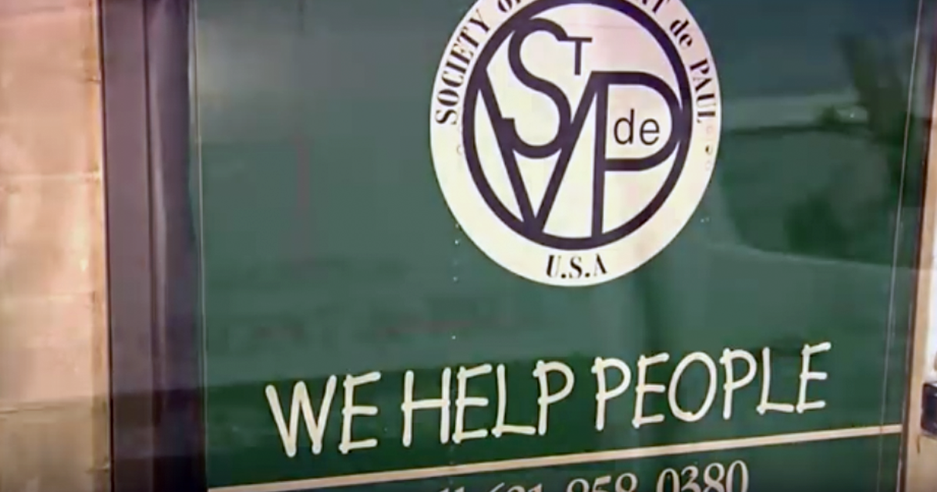
Framework:
Family to Family
We are neighbors helping neighbors
Built on trust, compassion, and mutual respect
A ministry of presence
Notes:
Notes:

Slide 10

The Interview – Discovery Through Dialogue
"Where are you now?“
"Where do you want to be?“
"What’s in the way?"
Notes:
Notes:

Slide 11

No active drug or alcohol use
High motivation to become self-sufficient
Honest communication and participation
Establishing Expectations
Notes:
Notes:

Slide 12
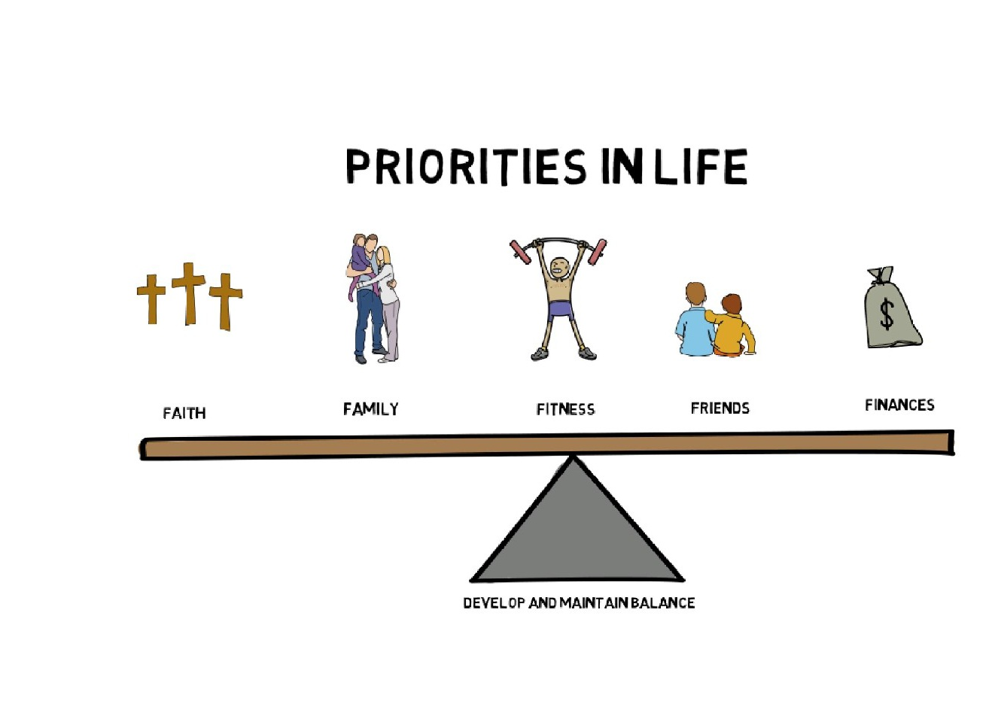
Faith
Family
Fitness (Health)
Friends (Community)
Finance (Stability)
Priorities in Life
Notes:
Notes:

Slide 13

Written Objective Statement
SMART Goals:
  Specific,
  Measurable,
  Achievable,
  Relevant,
  Time-Based
Personalized Coaching Plan
Creating THEIR Written Plan
Notes:
Notes:

Slide 14

Financial Understanding
Notes:
Budgeting isn’t just an attempt to reduce spending. It is a practice of setting targets for important/critical and other items with a goal in mind.
Those who have attended Ozanam Orientation or other training, may remember the distinction between situational poverty and generational poverty. In other terms, it is someone who a bump in what was a smooth road versus someone on a life long bumpy road or stable versus unstable. The far majority of our neighbors describe the cause of their need as situational: “if I hadn’t had car trouble”, “if I wasn’t off work”, “if I hadn’t missed a rent payment”. Ultimately many of their budgets have little or no excess income beyond their expenses.
Many haven’t added up and tracked their expenses over time. Income is less than expense temp or longer term.
How many people have used or are at least familiar with the practice of putting cash in separate envelopes for particular expenses? 2025 provides other options. .

Slide 15

Where does my money come from?
    “Income” list everything
Where does my money go?
    “Expenses” list everything
What’s my budget (pulls together income and expenses)?
    Positive or negative cash flow? This could reveal a surprise to neighbors.
    If it doesn’t match what they told you, they need to review it now and check it in the future.
What is fixed and what is variable for income and expenses?
    This could identify opportunities or the need to change something.
Income
&
Expenses
Notes:
WE CARE ABOUT YOU. WE ARE CONCERNED ABOUT FUTURE MONTH’S RENT AND UTILITIES!
Many of our neighbors are paid hourly for their work. Multiplying their wage by the hours in a month is not as accurate as using actual income, include Cal Fresh, cash aid, social security, tips, everything.
Estimating expenses for variable items isn’t always accurate. Example “S_____”. 8 months to understand expenses were off by nearly $1000.
Debts should include credit cards, bank or CU loans, cash advances, payday loans, loans from family, rent, utilities, and late fees past due. Ex: we always pay on the 10th of the month and are charged $50 late fee.
When is your next income? What are the risks and penalties for being late? What worries you that me haven’t talked about?

Slide 16
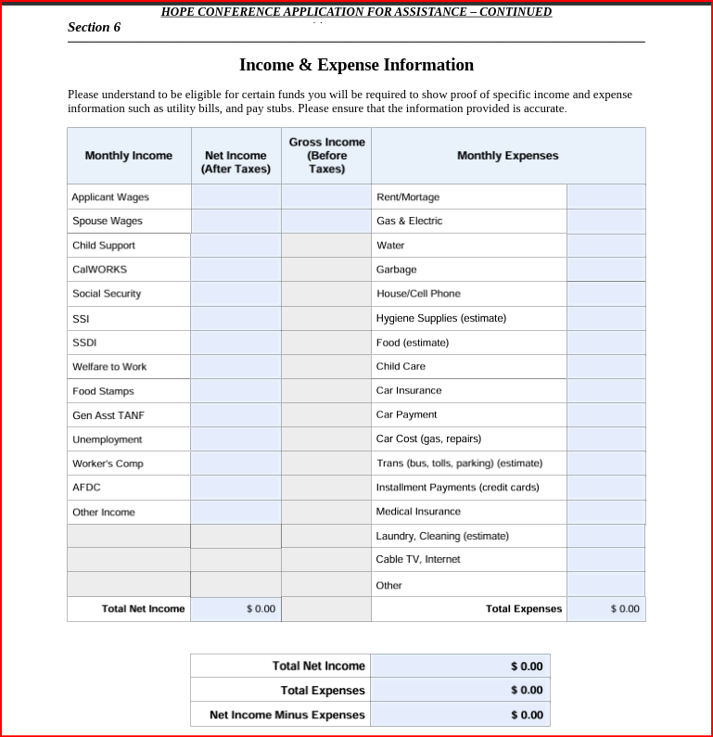
Knowing the Numbers
Budget form (including income and expenses and the net balance)
Short term payment resolution: Advocate/Teach/Negotiate/ Communicate with Landlords, PG&E, water co., auto loans, and bank
Debt log (list of all debts: monthly expense, due date, interest rate, pay off date)
Spending tracker: particularly helpful for variable expenses (food, utilities, transportation, eating out, entertainment and personal care)
Notes:
Often the budget forms like old SoS shows a clearer picture: last month, this month, next month. Budgets are dynamic.
Recognizing the cost associated with debts and priorities of payment is critical.
Debt log: credit cards, bank loans, cash advances, payday loans, loans from family, past due: rent, utilities, late fees.
We pay half of our rent around the 15th of the month and $50 late fee every month.
Making principle payments on 10% interest debt vs. 28% interest debt – not.
J & J Priorities: PG&E AMP! H2O debt, credit cards, Rent. Credit score ~700. Prioritizing bills: things I need for my job, things for housing, insurance, registration, other obligations.
Homeless neighbor was averaging $30/day on food and $7 per day on coffee, buying gifts for grandchildren, helping her daughter, buying clothing
Neighbors often consider budgeting just trying to spend less. Budgeting involve knowing where money is spent and targeting opportunities for improvement.
Using a spread sheet and it’s possible to keep a running total of cash available with income an expenses. Have you met folks who overdraw? Pay late fees? Have returned checks? Work totally with cash and pay check cashing? Cash flow plan: projecting ins and outs to conserve cash and reduce surprises and late fees
Needs for Job, needs for housing, needs for insurance, registration, repairs…..prioritize. How much? How late? Debt owner’s response.
Track progress/cash flow/debts – recognize small successes.

Slide 17
Seasonal expenses: heat & a/c, holiday giving, taxes, insurance, back to school. Seasonal incomes: overtime, tax returns, missed work, part time work, etc.
Ways to reduce spending: fees (ATM, late fees, check cashing), subscriptions, eating out vs. cooking, etc.
Ways to increase income: Work overtime, ask for a raise, get a “side hustle”, find a better paying job, sell stuff, check you tax withholdings
Side hustles: Lift or Uber, DoorDash, Instacart, baby sit, focus groups / surveys, tutor, teach English, rent a room or parking spot, become a personal chef, dog walk, pet sit, clean houses or offices, do tasks for people, mow lawns, wash cars, sell baked goods, etc.
Considerations and improving a Budget
Notes:
Considerations that impact expenses and incomes. What are expected seasonal changes? Does income and planning address short falls and opportunity for saving. Are their times when we need to be frank with our neighbor in need. You can’t afford your apartment, a car, cable tv, four cell phones, etc.? With a clear picture, will paying their back rent put them in a position to meet future expenses? Are they self sufficient or do they go from church to friends to parents to pantries? Can SVdP help with food, clothing, donated items to help temporarily or permanently keep their budget in the black? How easy is it to change a habit? How do we provide the right kind of coaching and hope?

Slide 18

Micro Loan Program
Notes:
Here’s an opportunity for assisting a Neighbor in need with a change that addresses a small immediate need and starts them on a change that can have a lasting effect.

Slide 19

Conference visitors’ considerations:
Is family budget sufficient to make payments on a low interest loan?
Do they appear to be stable in income and expenses, housing?
Are they open to moving toward a more stable situation, a bank account (if they don’t have one) and better credit?
SVdP Micro
Loan Program
Notes:
Loan are appropriate for current expenses or past debt. With SVdP collateral (secured loans), interest rate are very low.

Slide 20

SVdP Micro
Loan Program
(Outcomes)
Provide neighbors with an alternative to high interest loans.
SVdP provides mentorship & financial education.
Several SVdP Councils have low-interest loan programs. These mature programs have given us guidance as we designed this program.
SVdP Dallas: Converted 568 Payday loans and made 96 emergency low-interest loans, (3 years):
    Saved $2.4 million in fees
    Saved 179 vehicles from repossession
Notes:
Loan are appropriate for current expenses or past debt. With SVdP collateral (secured loans), interest rate are very low. Paying off a $2000 loan in 18 months may cost $125 per month. Our goal is to for positive change (we want to improve their future). There are basic forms and tools to coach them through learning about how finances, debts, credit and savings work. low interest loans to neighbors, initially approx. 3% and $2000 or less.

Slide 21

Neighbors will establish an account with partner credit union and improve their credit scores.
Vincentians and mentors will check in with the neighbor routinely.
Monitoring reports will assure that payments are being made and to address circumstances in which they can assist.
SVdP Micro
Loan Program
(Monitor for Success)
Notes:
We can accompany them to sign the documents and get a check for the loan within three days. Our goal is to support them in not defaulting on the loan. Staying in touch is important. Addressing any challenges and maintaining their commitment to repayment.
Future loans depend on loan repayments.

Slide 22

Micro Loan Committee
Anne Crisp: Annecrisp@yahoo.com (925)787-0857
Ron Costanzo: Rcostanzo@astound.net (925)487-4986
Joyce Ohanesian: Joy1936@comcast.net (925)513-7124
Shawnna Costanzo: Shawnna57@gmail.com (925)200-5952
Contact Us
Notes:
We want to be very responsive. With the right neighbors, we will be fastest to respond and fund – if the neighbor and timing are right maybe about a week.

Slide 23

Developing Local Resources
Intake Screening Evaluation Form
Resource Guidelines Matrix
Apply to SOS and CCEB
Referral Service List

Slide 24
Intake Screening Evaluation
Notes:
Notes:

Slide 25
Resources Guidelines
Notes:
Notes:

Slide 26


Applying to Season of Sharing (SOS) and
Catholic Charities (CCEB)
Prior to applying to the Hope Conference, follow these steps:
Step One –
Send separate emails to SOS and CCEB with the name(s), birthday, and Social Security Number for everyone over 18 years of age to verify if they are eligible for assistance i.e., have they been helped within the last five years. For emails to CCEB you may also ask if they have funds for the assistance you are requesting.
Step Two –
If any member of the household has received assistance within the last five years by both SOS and CCEB, they are ineligible to apply for assistance. You can apply to the Hope Conference.
Notes:
Notes:

Slide 27
Applying to Season of Sharing (SOS) and
Catholic Charities (CCEB)
Prior to applying to the Hope Conference, follow these steps: (continued)
Step Three –
If the neighbor is eligible for assistance:
  First, apply to SOS.
  If funded the full amount requested, there is no need to apply to CCEB or the Hope Conference.
  Second, apply to CCEB only if SOS has provided no, or partial funding. (Note: use the Hope Conference application and Release of Information form)
  Third, apply to the Hope Conference only when the total amount of funds needed was not funded by SOS and/or CCEB.
  Fourth, applying for a Micro Loan is also an option.
Notes:
Notes:

Slide 28
Notes:
Notes:

Slide 29


SVdP Contra Costa Website
(Member Section)

Slide 30
Members
  Assistance Applications
  PG&E
  Conference Operation
  Home Visits
  Food Pantry
  Help Offered by Other Organizations
  Misc Videos
  Tuesdays with Vincent
  Vetera Monimenta
SVdP Contra Costa Website
https://www.svdp-cc.org/
Notes:
Notes:

Slide 31
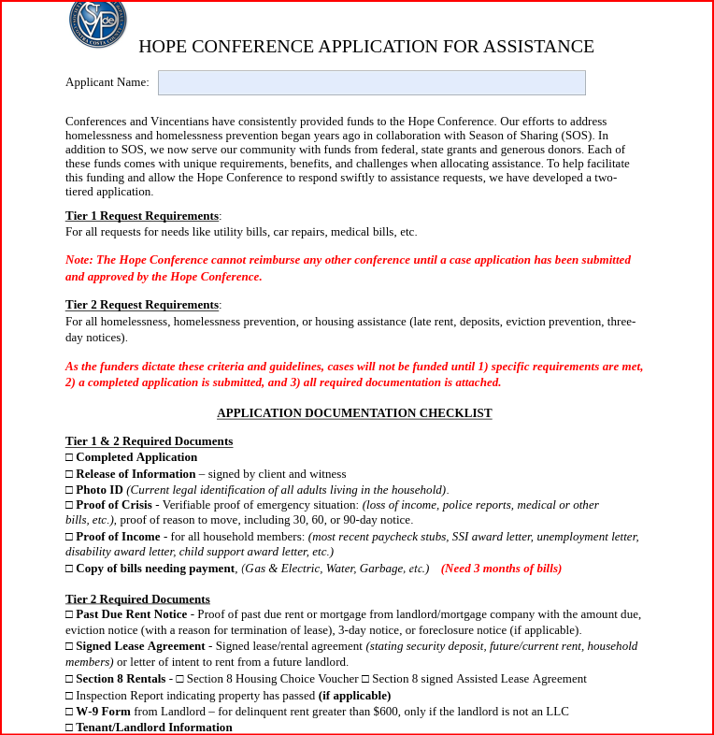
Hope Application

Slide 32

Application Submission Requirements
Deadline: Applications must be submitted by the Wednesday before the upcoming Hope Conference Meeting.
  Late submissions will be reviewed at the following scheduled meeting which can result in delayed payments.
Document Format: All documents must be submitted in PDF format. JPEGs or image files will not be accepted.
File Consolidation: If possible, combine all documents into a single PDF.
Email Limit: Submit no more than two emails per application. Only send multiple emails if necessary.
Notes:
Notes:

Slide 33

Application Intake Process
A designated Hope Conference Case Manager will screen each email.
Documents are saved in a case folder and assigned:
  Case Number
  Case Manager
A confirmation email is sent to the Vincentian submitting the application and the Case Manager.
Notes:
Notes:

Slide 34
**Tier One – Non-Housing Assistance**
Completed Application
Signed Release of Information
Photo IDs (for all household members 18+)
Proof of need or crisis
Proof of Income (for all household members 18+)
Utility or Other Bills:
  Last 3 months of complete utility bills
  Invoices or receipts for other expenses
Important: Cases will not be reviewed unless all required documents are submitted in full and correctly completed. This will cause a delay of payment.
Required Documents
These are the funder’s requirements
Notes:
Notes:

Slide 35
Required Documents
These are the funder’s requirements
**Tier Two – Housing Assistance**
All Tier One documents (except utility bills or other expenses), plus:
Past Due Rent Notice (if applicable)
Signed Lease Agreement (minimum required first and signed pages)
Rental Ledger (if available)
Completed W-9 Form from Landlord
Tenant/Landlord Information Form
Section 8 Documentation (if applicable)
Important: As with Tier One, cases will not be reviewed unless all required documents are submitted in full and correctly completed. This will cause a delay in payment.
Notes:
Notes:

Slide 36
Initial Review – Incomplete Submissions
The Case Manager will review submissions for completeness.
The Case Manager will check the Seattle DB for previous assistance provided.
If documents are missing and or incomplete:
  The Case Manager email the Vincentian submitting the application for documents or information needed
  The case is placed in “Pending" status.
If missing or incomplete documents are not received by the date requested the case will be deferred to the next Hope Conference Meeting.
The case will be “Closed” if missing or incomplete documents are not received by the second meeting. (A new application must be submitted with updated information.)
Notes:
Notes:

Slide 37
Once all documents are received:
The Case Manager conducts a thorough review focusing on:
  The need or crisis
  Household income and expenses
  Sustainability plan
  Support or twinning options from the Parish Conference
  Willingness of landlord or utility company to establish payment plans
Case Review – Complete Submissions
Notes:
Notes:

Slide 38
The Case Manager presents the case to the Hope Conference, including:
Summary of facts
Analysis and recommendation (approval/denial)
The Hope Conference members discuss and vote too:
  Approve full or partial assistance
  Deny the request
The Case Manager will notify the Vincentian of the decision and provide reasons if partially funded or denied.
Final Review – Hope Conference Decision
Notes:
Notes:

Slide 39
Before submission to the Hope Conference, the Vincentian must vet the neighbor though Season of Sharing (SOS) and Catholic Charities (CCEB).
Applications must be submitted by Wednesday before the next scheduled Hope Conference Meeting.
PDF format only; no JPEGs.
Combine documents into one PDF when possible.
Limit to two emails per submission.
Applications with missing or incorrect documents will not be reviewed and placed on “Pending” status.
If missing or incomplete documents are not received by the requested date the case will be deferred to the next Hope Conference Meeting.
If missing or incomplete documents are not received by the second meeting, the case will be “Closed”. A new application with updated information will be required.
Summary of Key Rules & Guidelines
Notes:
Notes:

